Slide 1
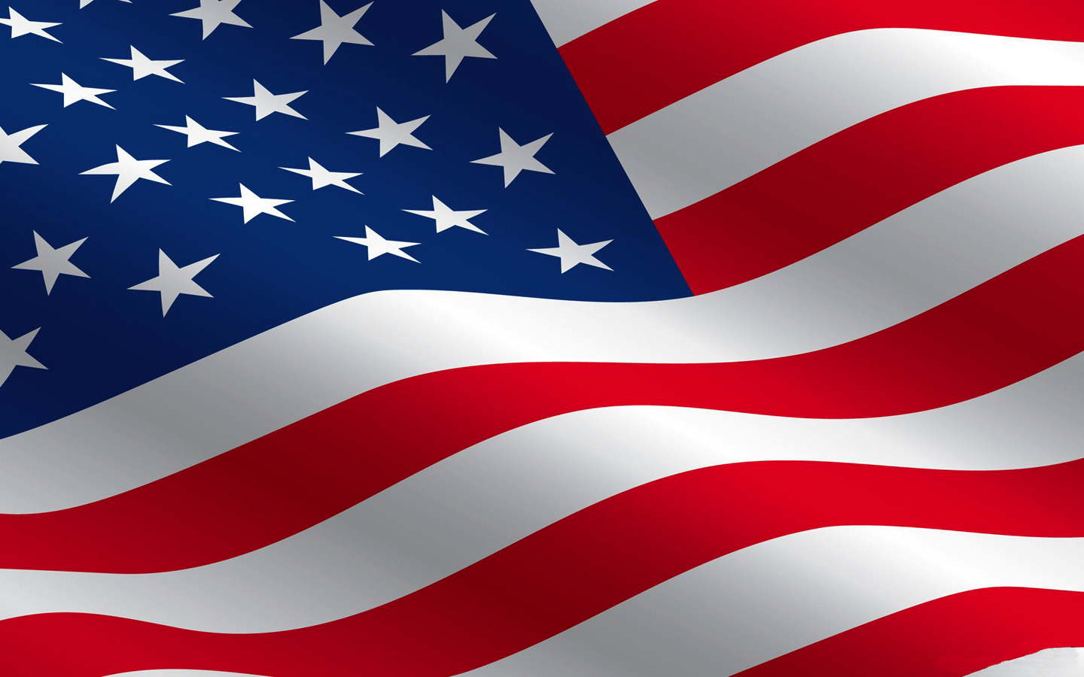
America’s Flags

Slide 2
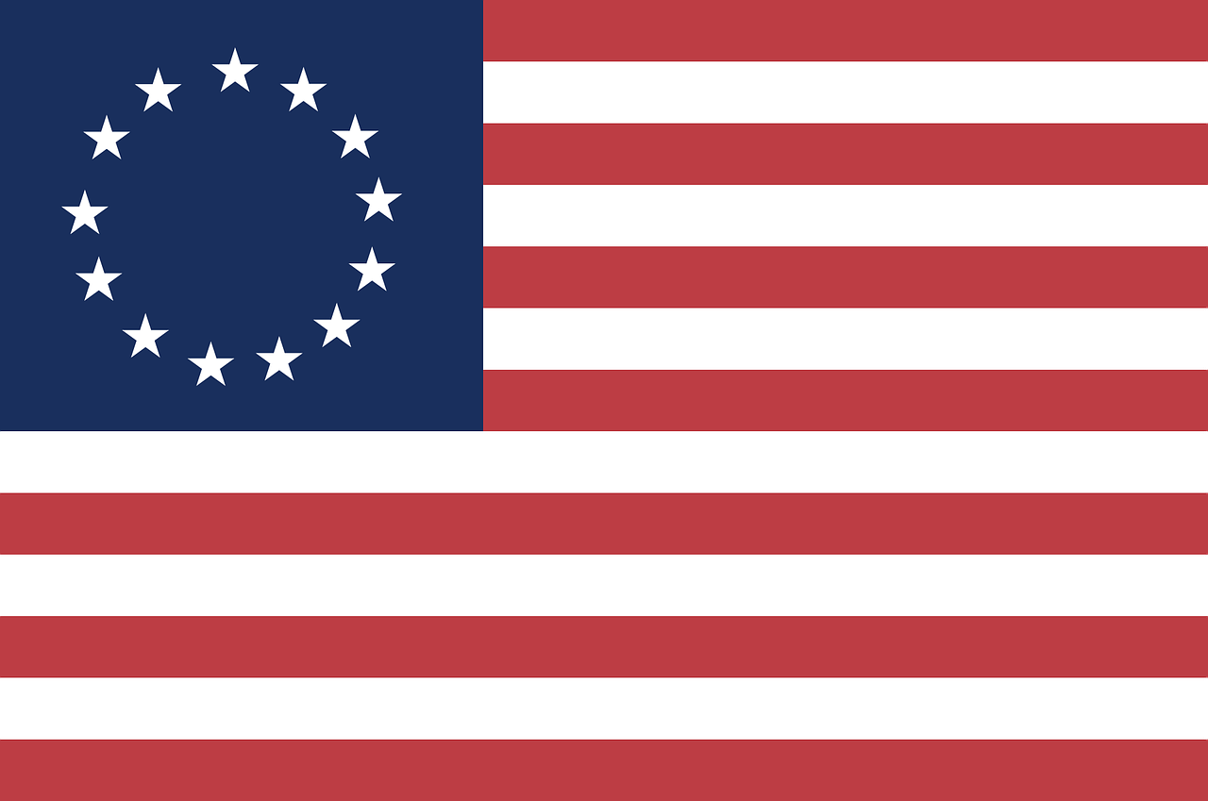
Thirteen Stars – The Betsy Ross Flag

Slide 3
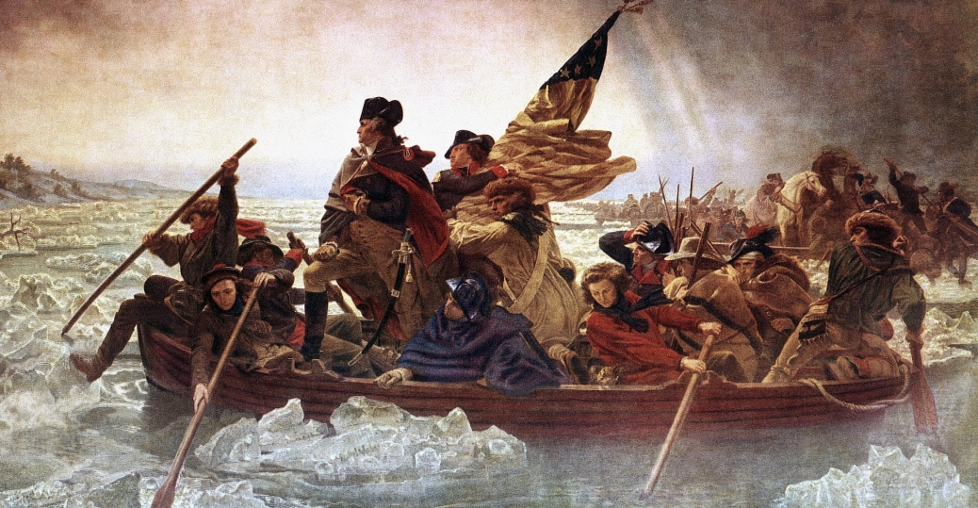
America’s Revolutionary War
We declared our independence in 1776
General George Washington led the troops
2

Slide 4
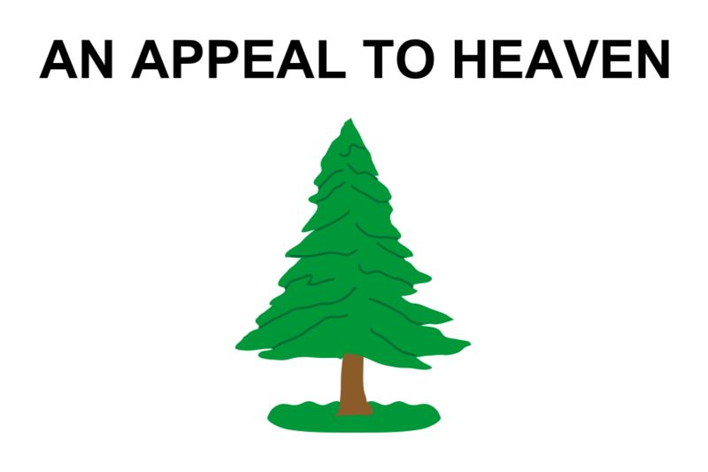
The Colonies First Flag
Liberty Tree
Flown by General George Washington before the Revolutionary War
3

Slide 5
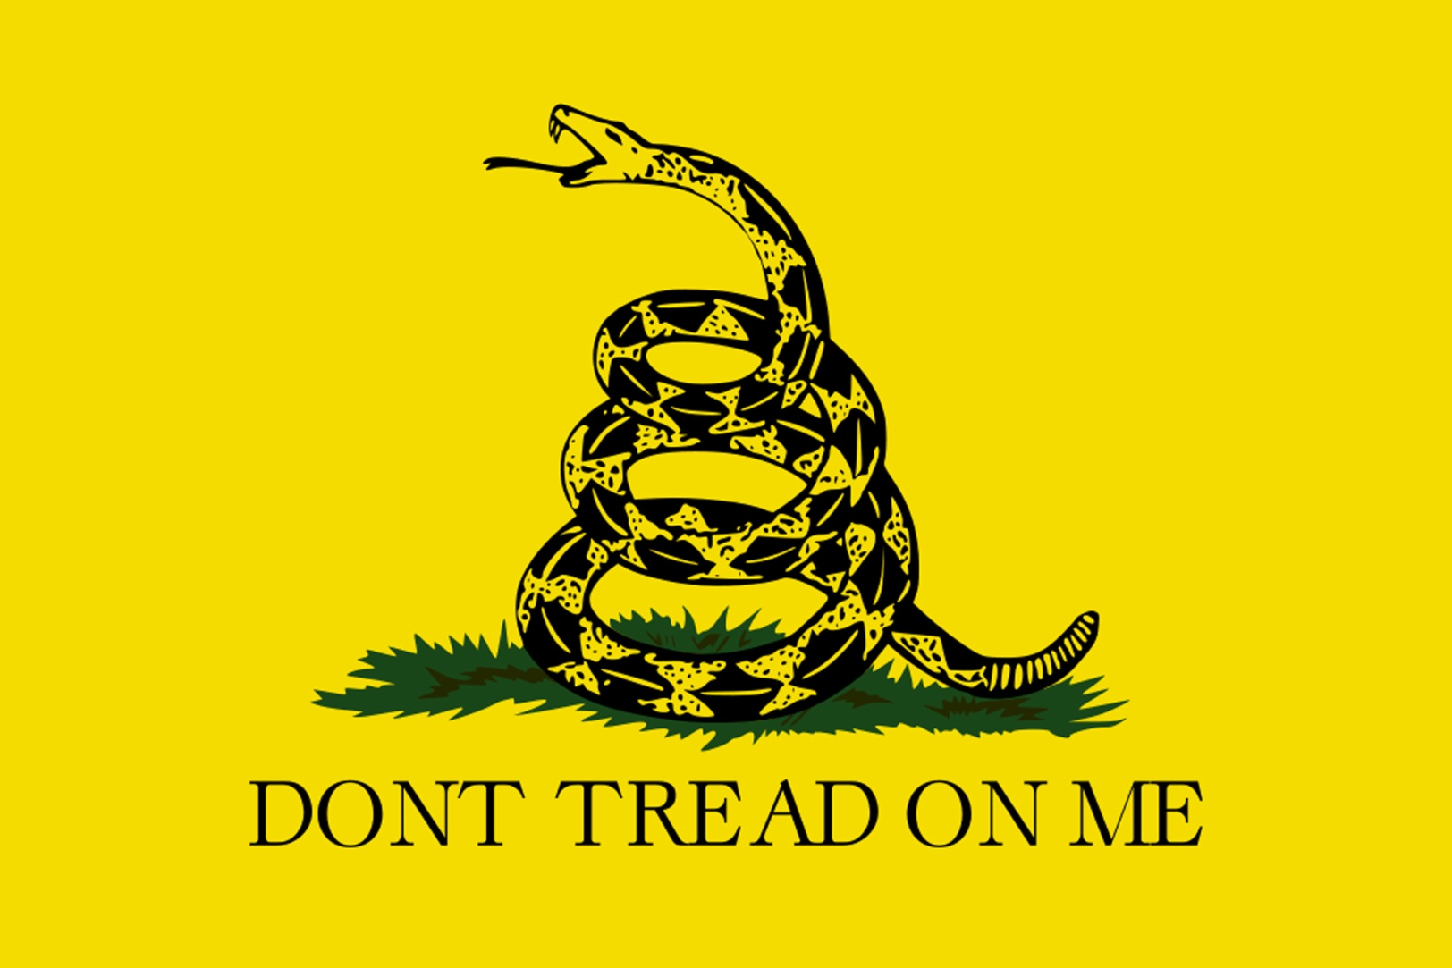
Continental Marines
Do you recognize the snake?
Rattlesnake
Also known as the Gadsden flag
4

Slide 6
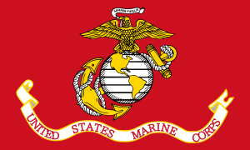
Marine Corp Flag
The Marine Corp and its’ flag was created before the Revolutionary War
November 10, 1775
5

Slide 7
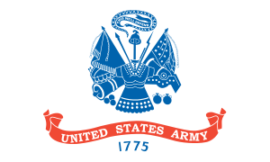
The Continental Army
The Army and its’ flag were created before the Revolutionary War
June 14, 1775
6

Slide 8
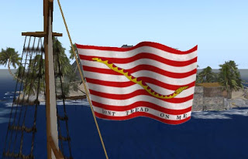
The Continental Navy
The Navy and its’ flag were created before the Revolutionary War
October 13, 1775
7

Slide 9
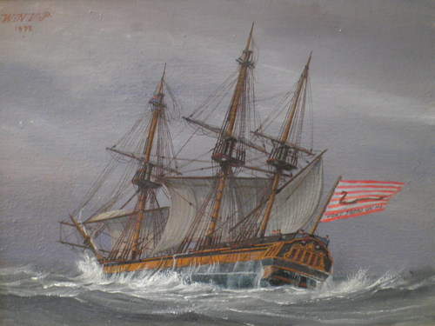
The Continental Navy
A Navy ship sailing in the ocean.
October 13, 1775
8

Slide 10
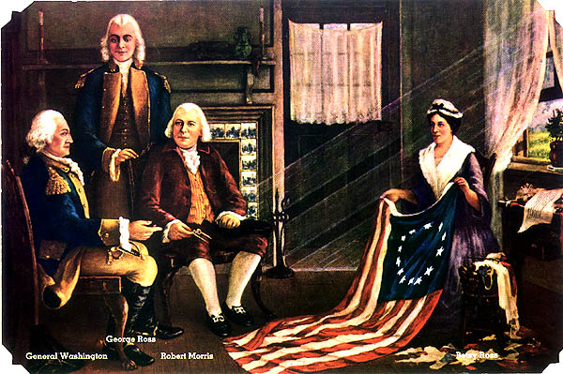
Betsy Ross Meets General Washington
Betsy Ross was a seamstress
Who Was Betsy Ross?
Betsy sewed the 13 star flag
Frances Hopkinson designed the flag
9

Slide 11
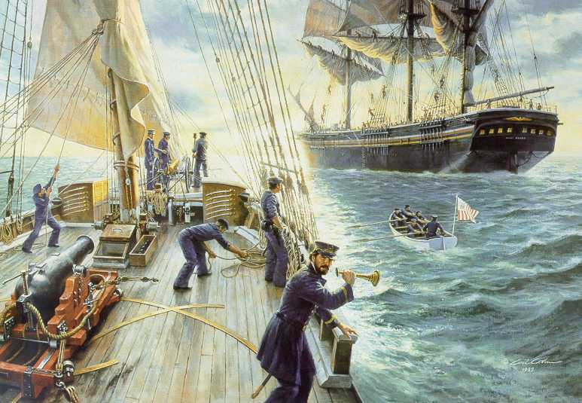
1790 – The United States Coast Guard
Why did we need the Coast Guard?
To protect our shores and water ways
10

Slide 12
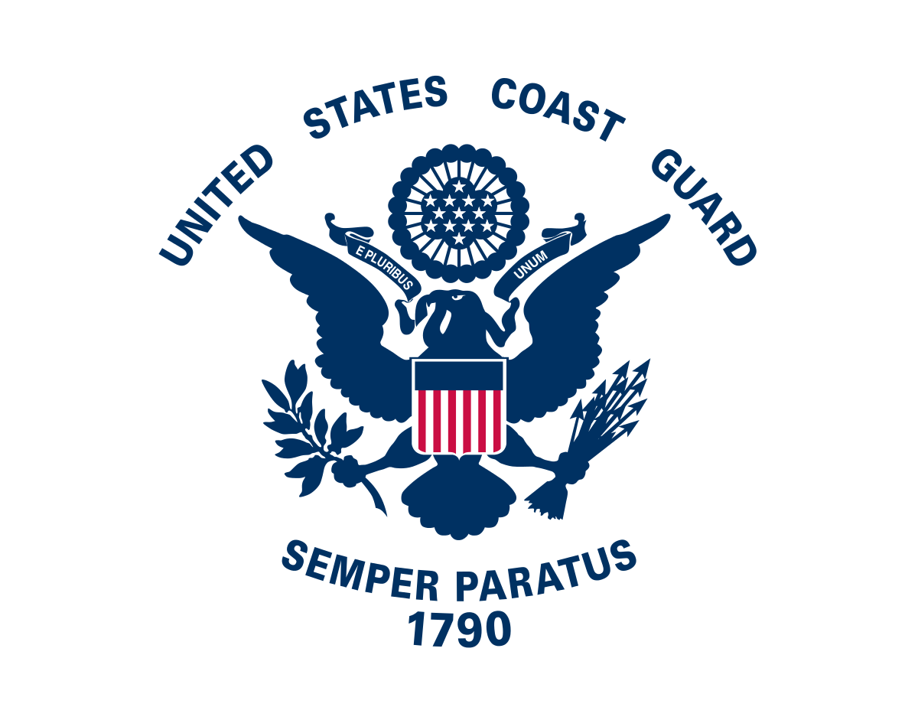
1790 – The United States Coast Guard
What does “Semper Paratus” mean?
“always ready”
11

Slide 13
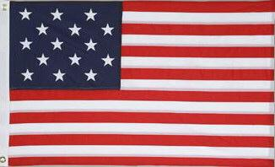
1791 – The Stars and Stripes
Fifteen Stars!
Other colonies had joined America.
12

Slide 14
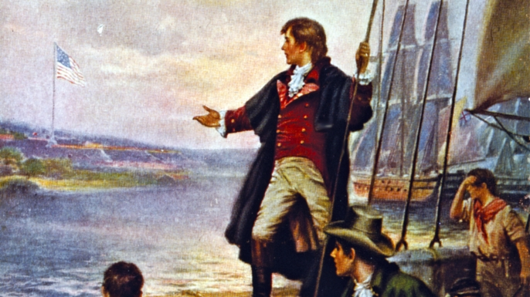
1814 – Frances Scott Key
The Star Spangled Banner
13

Slide 15
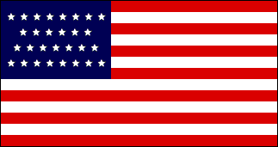
1847 – 29 Stars for 29 States
14

Slide 16
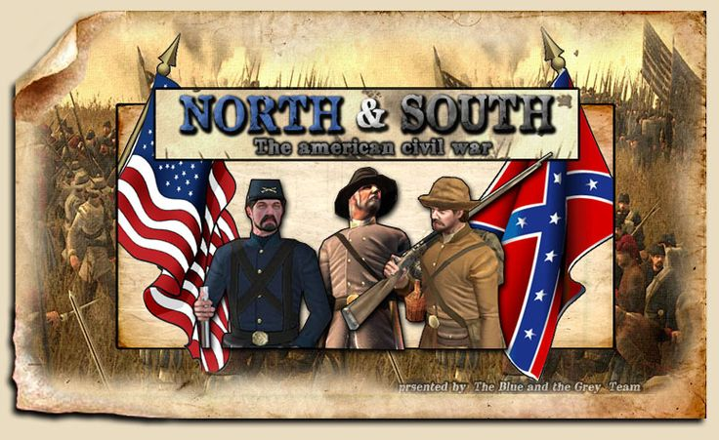
American Civil War 1891 - 1865
Freedom for all people.
States rights: the Southern states did not want to adhere to the US Constitution.
15

Slide 17
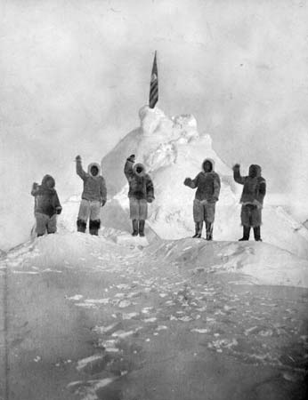
Admiral Robert Peary Planted the Flag
North Pole
1909
16

Slide 18
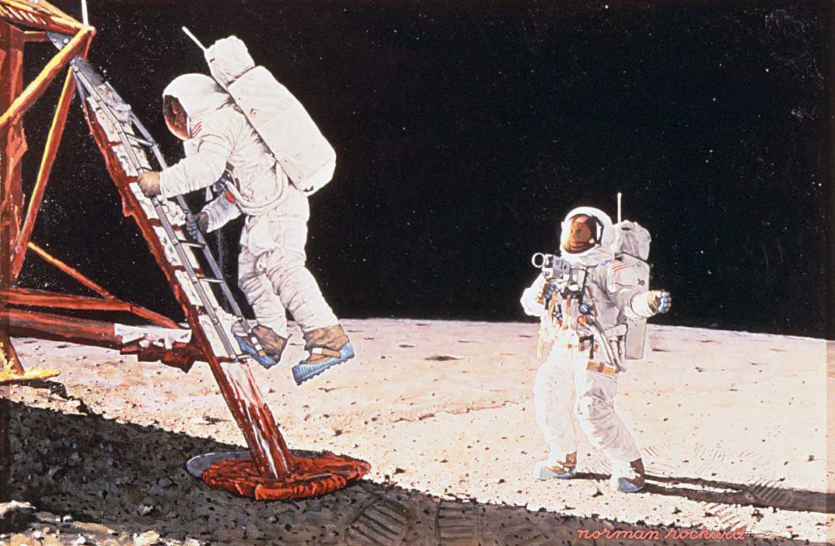
Neal Armstrong Planted the Flag
1969
Painting
by
Norman Rockwell
17

Slide 19
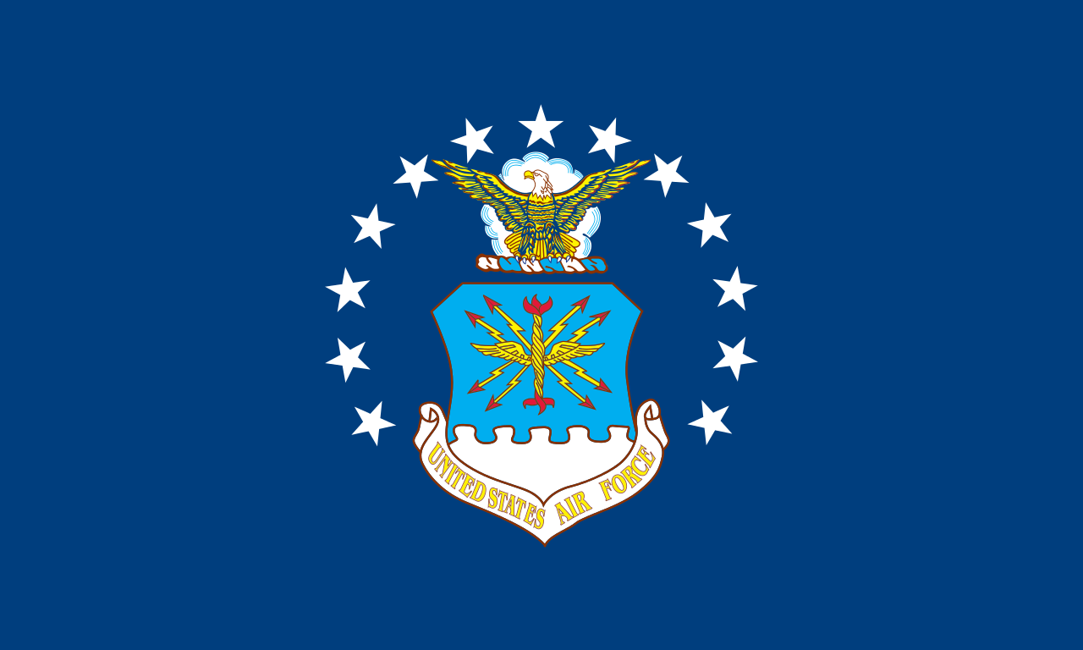
United States Air Force
September 18, 1947
18

Slide 20
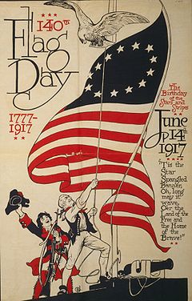
America’s Flag Day
June 14, 1949
The day the flag was adopted & the birthday of the U.S. Army
19

Slide 21
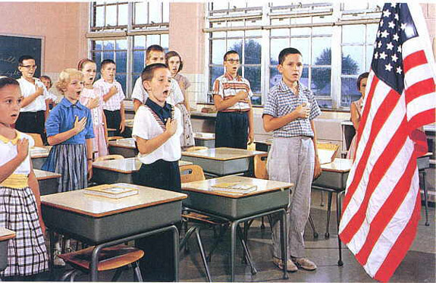
The Pledge of Allegiance
1954
“Under God” was added to the Pledge of Allegiance
20

Slide 22
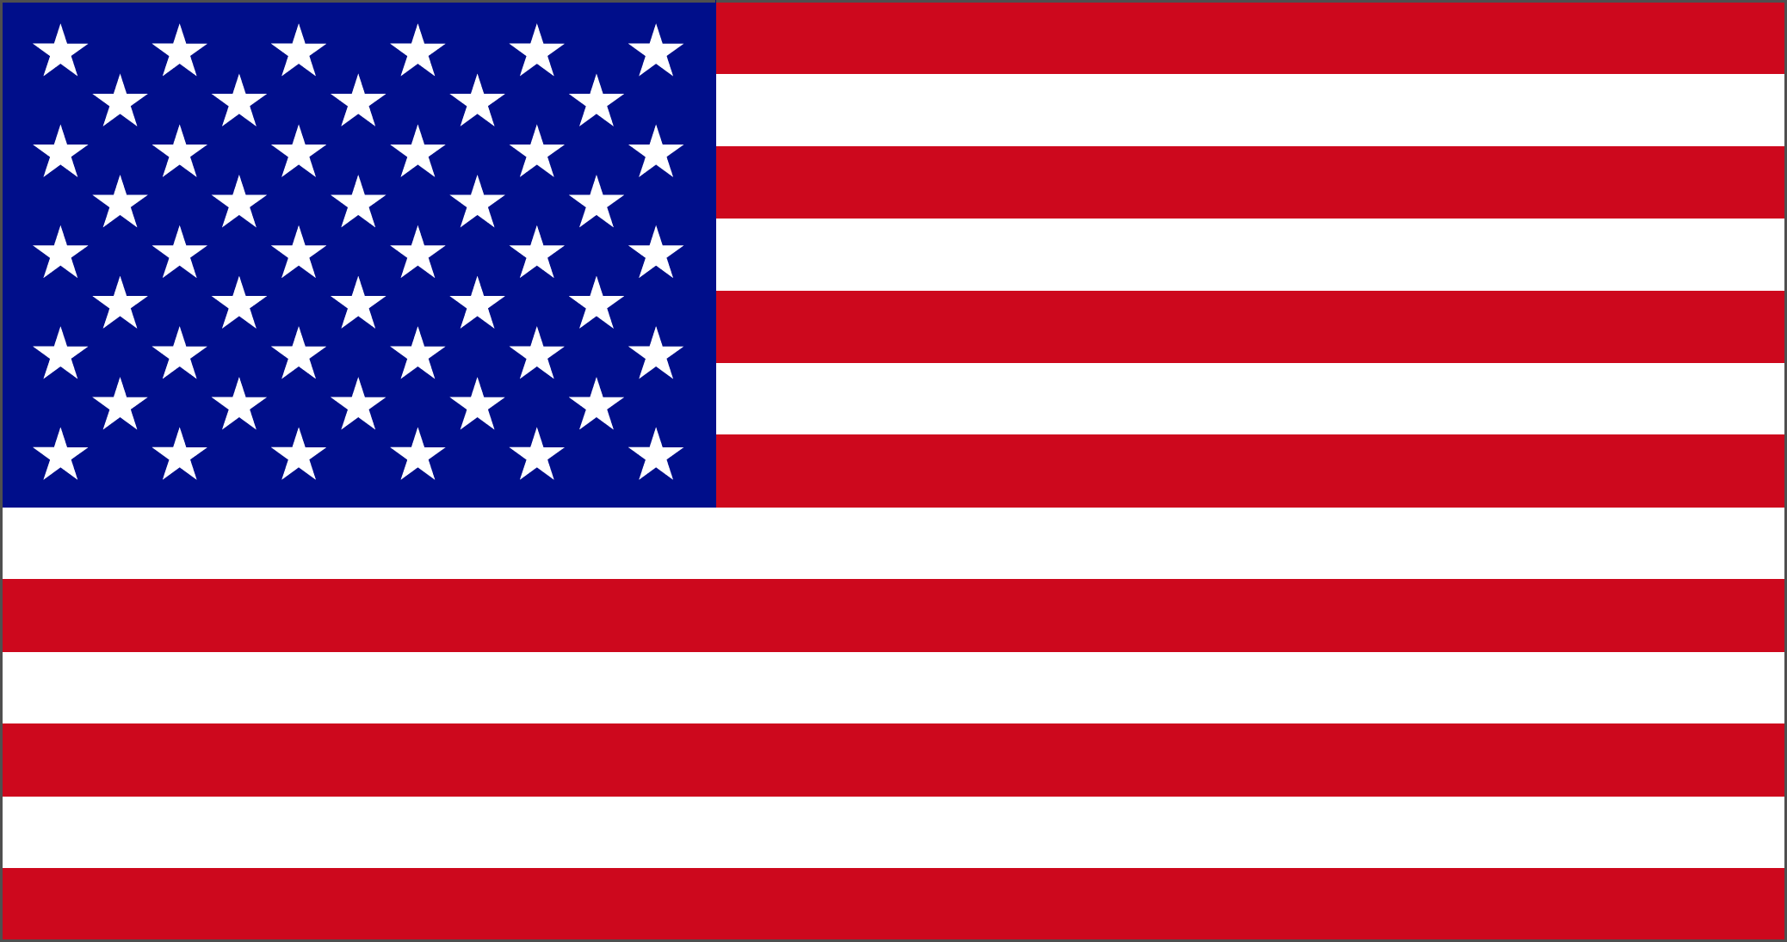
Alaska and Hawaii
Alaska and Hawaii became states in 1959
Q: Which were the last two territories to become states?
A: Alaska & Hawaii
21

Slide 23
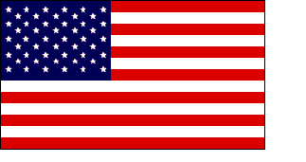
Flag Symbolism
Red
Hardiness
Valor
13 Original Colonies
Symbolism
White
Purity
Innocence
22

Slide 24
Flag Symbolism
Blue
Perseverance Vigilance
Justice
23

Slide 25
Flag Symbolism
The Stars are
symbols of the Heavens
24

Slide 26
Flag Knowledge Points
Q: Is burning the flag is against the law?
A: If a flag is worn & tattered, it may be retired by burning in a dignified manner
Q: How many American flags have been planted on the moon?
A: Six
Q: How many American flags planted on the moon are still flying today?
A: Five
25

Slide 27
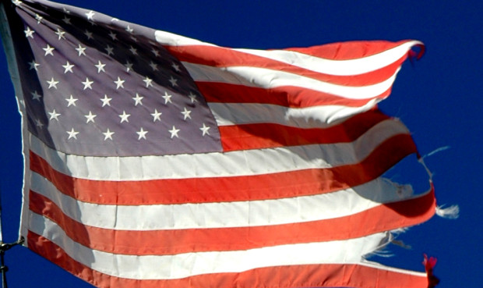
Flag Knowledge Points
Q: Is burning the flag is against the law?
A: If a flag is worn & tattered, it may be retired by burning in a dignified manner but it may not be burned for any other reason
26

Slide 28
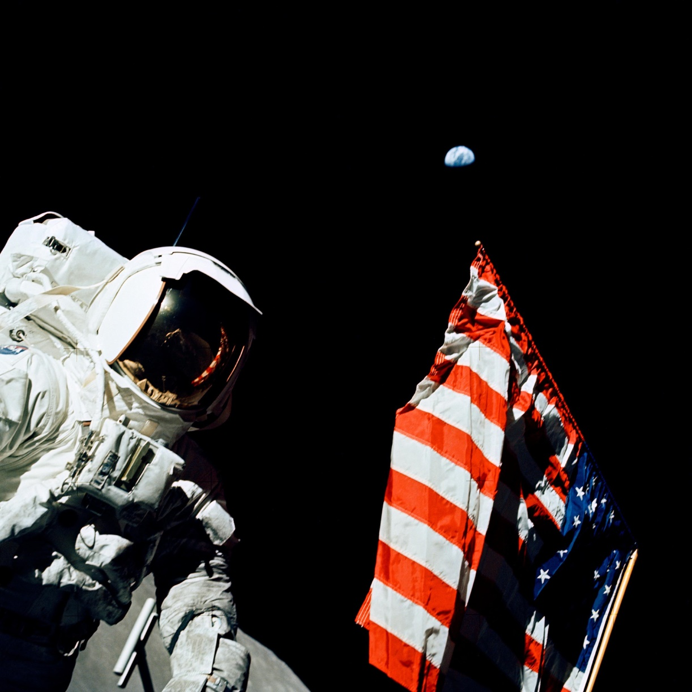
Flag Knowledge Points
Q: How many American flags have been planted on the moon?
A: Six
27

Slide 29
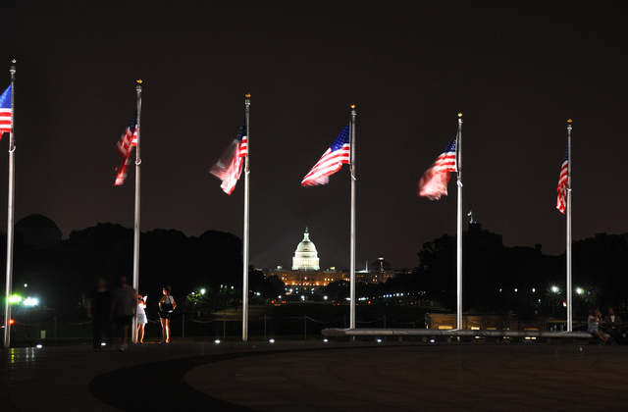
Flag Knowledge Points
Q: What are the rules for displaying the American flag?
Must never touch the ground
Never be bunched, scrunched or tied
Sunrise to sunset or illuminated at night
28

Slide 30
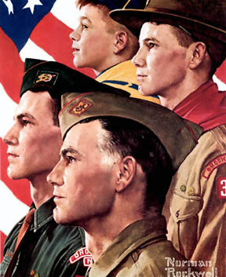
The Boy Scout Calendar
Norman Rockwell painted
for the
Boy Scouts
for 60 years
29

Slide 31
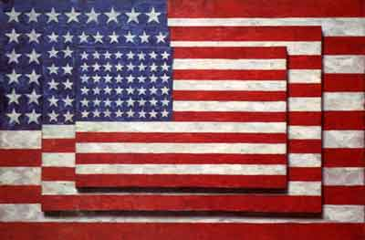
Three Flags by Jasper Johns
30

