Slide 1
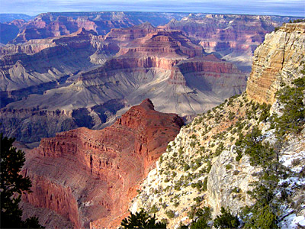
The Grand Canyon

Slide 2
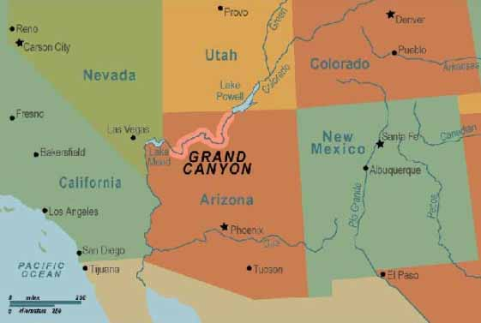
Where is the Grand Canyon located?
Arizona
1

Slide 3
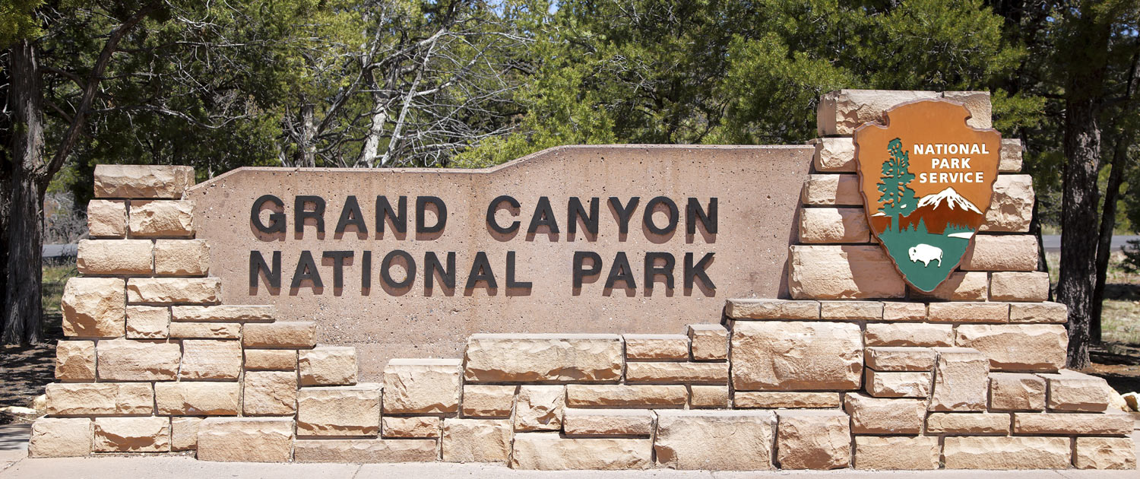
Three National Parks in Arizona
Grand Canyon
Petrified Forest
Saguaro National Park
Grand Canyon
Petrified Forest
Saguaro National Park
1919
2

Slide 4
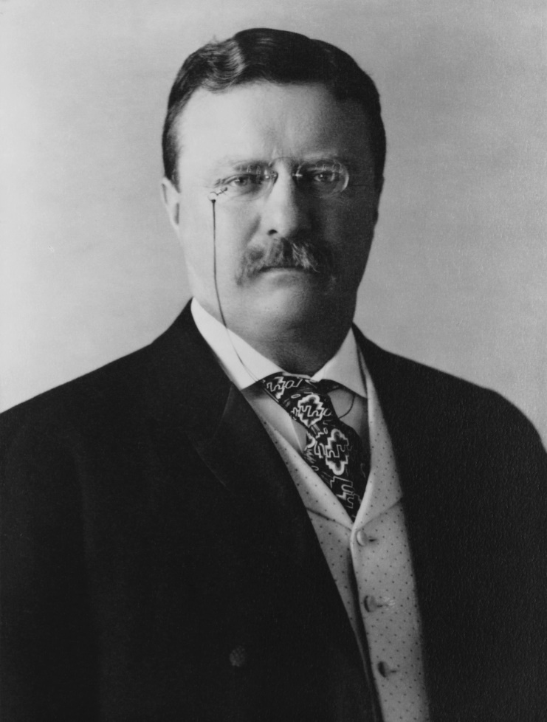
The National Park Service
In 1916 which President founded the National Park Service?
3

Slide 5
The National Park Service
In 1916 which President founded the National Park Service?
President
Theodore Roosevelt
4

Slide 6
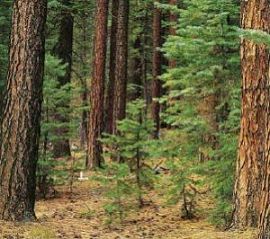
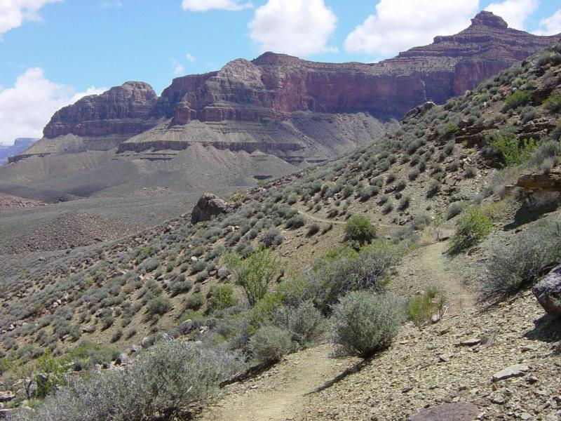
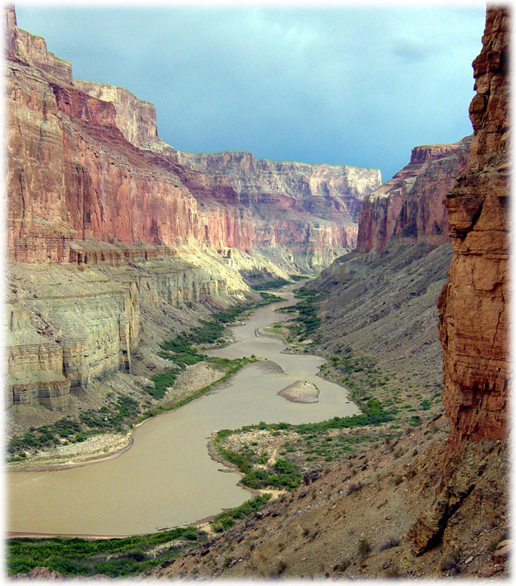
Ecosystems of the Grand Canyon
North Rim
South Rim
Colorado River
5

Slide 7
The North Rim
Largest Ponderosa Pine Forest in the US
Smells like vanilla
Bark is 4” thick and great protection from fires and beetles
6

Slide 8
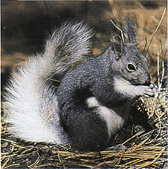
The North Rim
The
“Albert Squirrel”
Only found on the North Rim
7

Slide 9
South Rim (West End)
Which animals live on the South Rim?
8

Slide 10
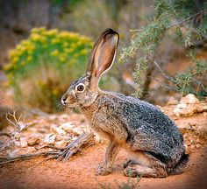
South Rim - Jackrabbits
9

Slide 11
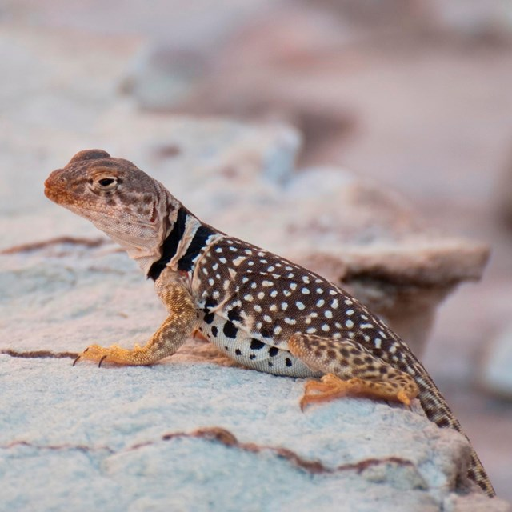
South Rim Lizards
10

Slide 12
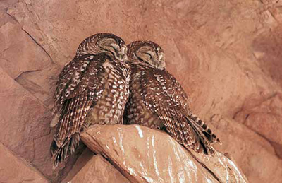
South Rim Owls
11

Slide 13
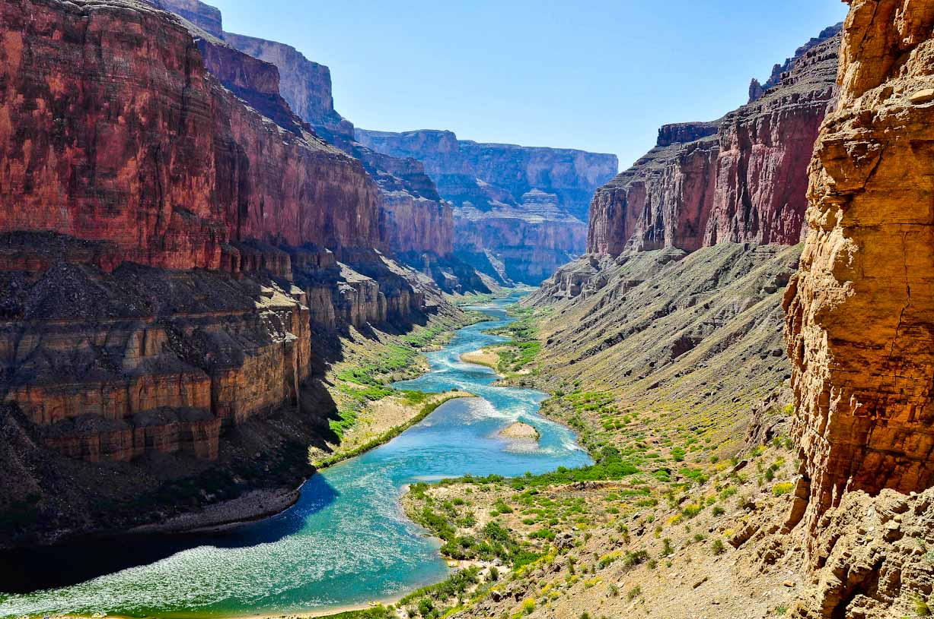
The Colorado River
Where does the Colorado River begin & end?
High up in the Rocky Mountains
Gulf of California
12

Slide 14
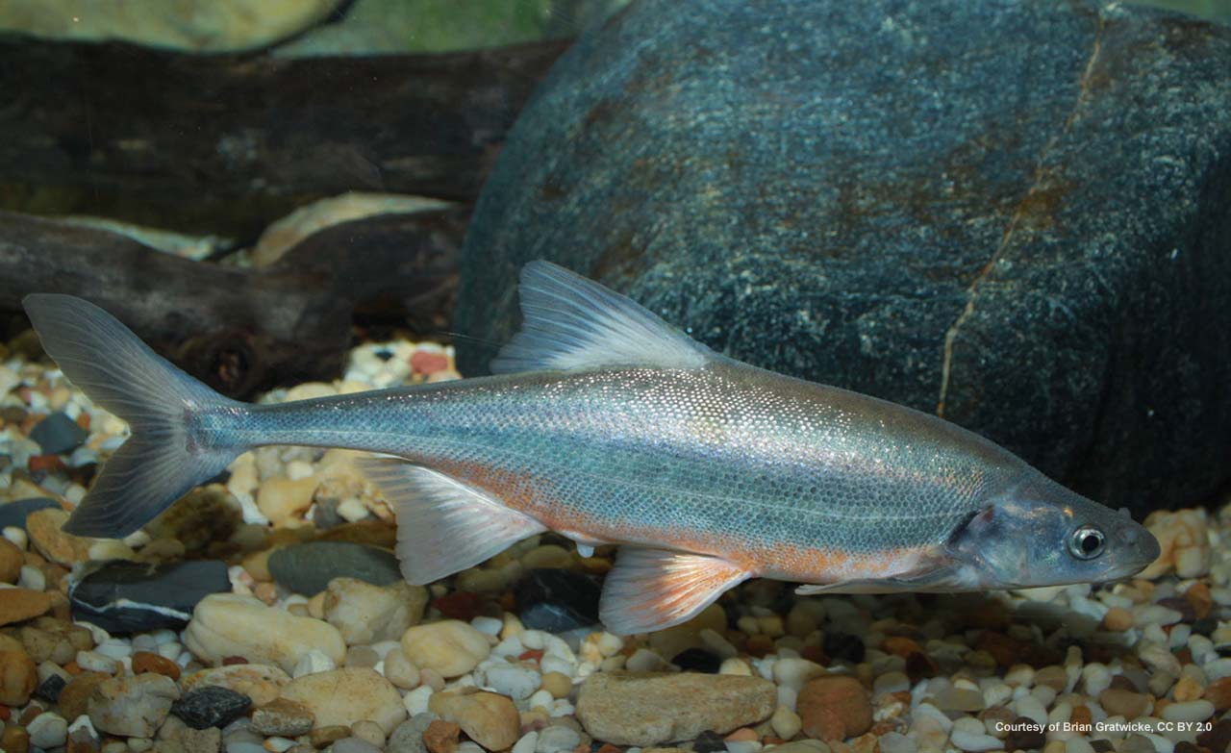
Colorado River Fish
13

Slide 15
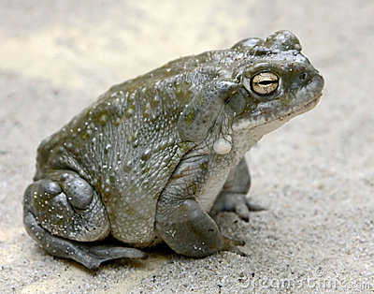
Colorado River Toad
14

Slide 16
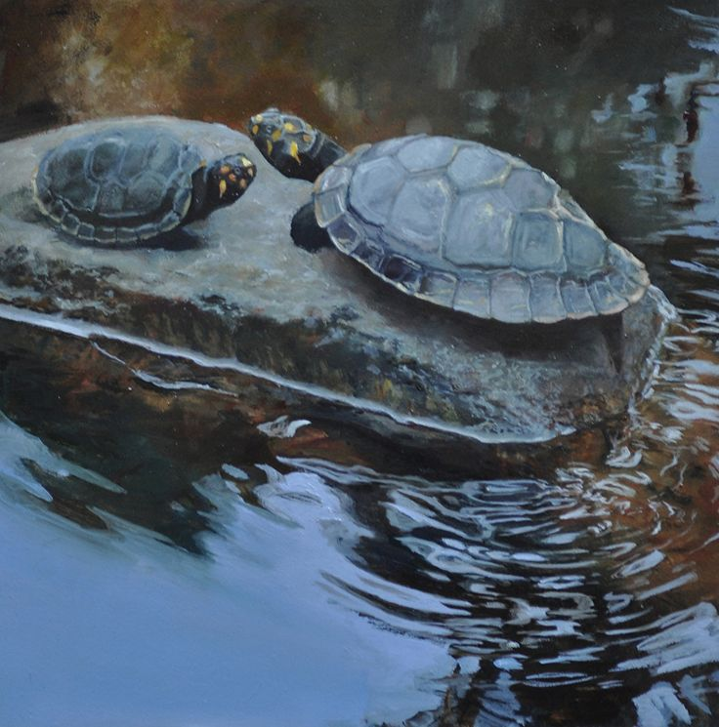
Colorado Western Turtle
15

Slide 17
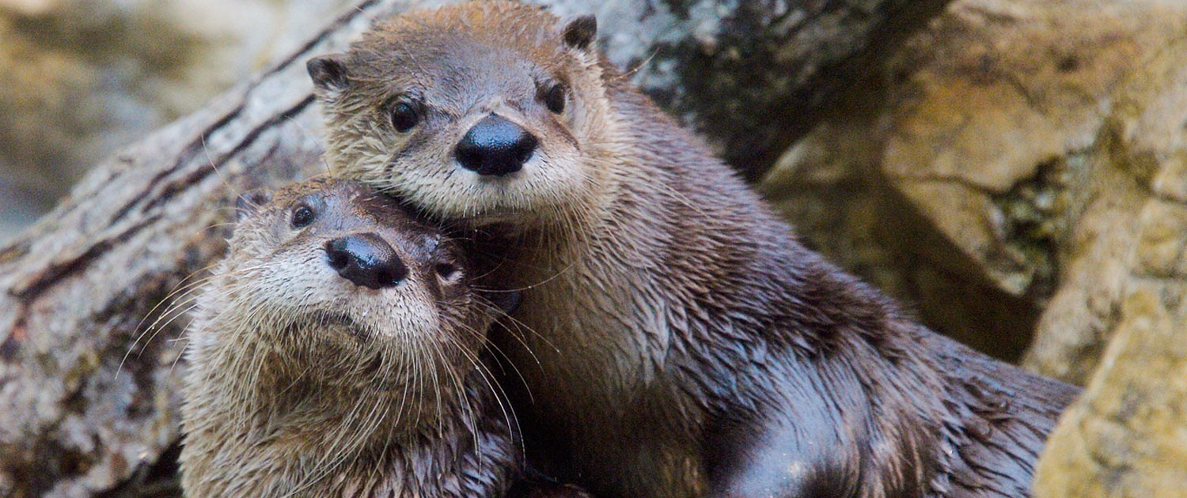
The Colorado River Otter
16

Slide 18
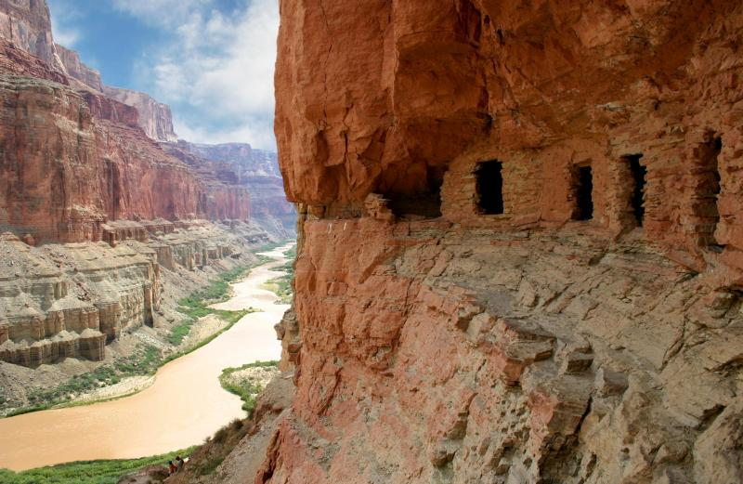
The First People – 2000 Years Ago
Nomadic Indian Tribes
Over the past 2,000 years, 9 different tribes have inhabited the Grand Canyon
17

Slide 19
The First People
The granaries are where they stored their food
18

Slide 20
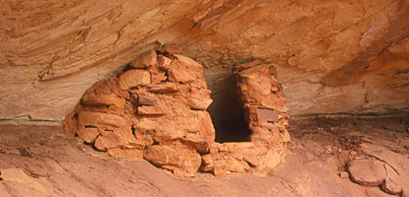
The First People – Stacked Stone
The granaries were made out of stacked stone
19

Slide 21
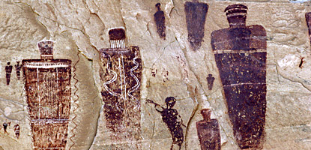
Pictographs
20
https://www.youtube.com/watch?v=BrluNutLNpc

Slide 22
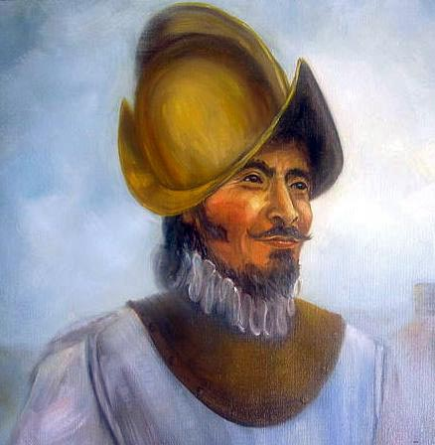
The Spanish Explorers
The next group of people to explore the Grand Canyon were the Spanish Explorers.
21

Slide 23
The Spanish Explorers – 1500’s
Francisco Vázquez de Coronado y Luján
He was sent by the Queen & King of Spain to find new territory
22

Slide 24
The Spanish Explorers – 1500’s
Francisco Vázquez de Coronado y Luján
He was also sent to find GOLD
23

Slide 25
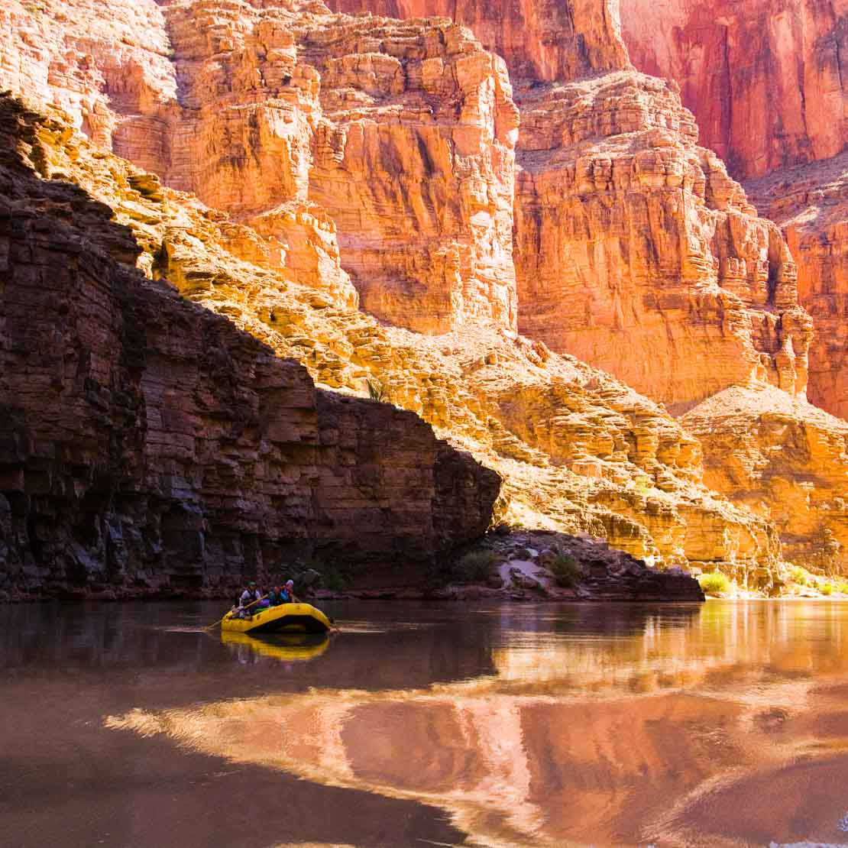
The Spanish Explorers
When Coronado saw the canyon walls he thought he had found GOLD!
24

Slide 26
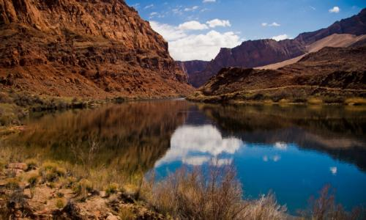
The Grand Canyon
How old is the Grand Canyon?
26

Slide 27
The Grand Canyon
How old is the Grand Canyon?
6 million years old
21

Slide 28
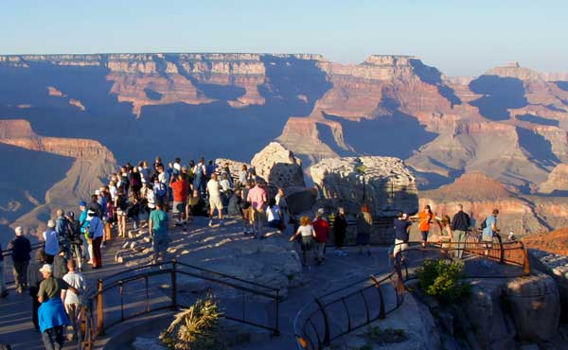
The Grand Canyon
How many people visit the Grand Canyon each year?
27

Slide 29
The Grand Canyon
How many people visit the Grand Canyon each year?
5 Million
28

Slide 30
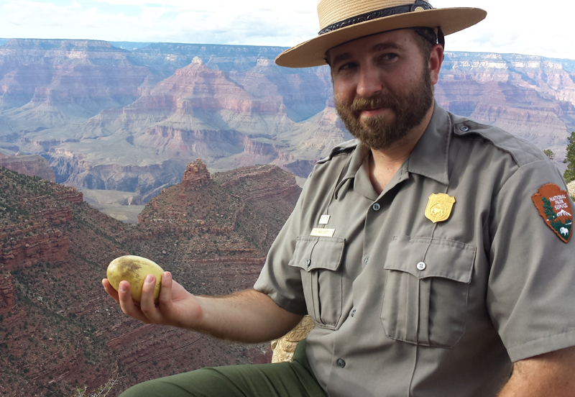
The Grand Canyon Rangers
Maintain the park
Protect the environment
Lead hikes & educational talks
29

Slide 31
The Grand Canyon Rangers
What is the ranger holding?
30

Slide 32
The Grand Canyon Rangers
What is the ranger holding?
A California Condor egg
31

Slide 33
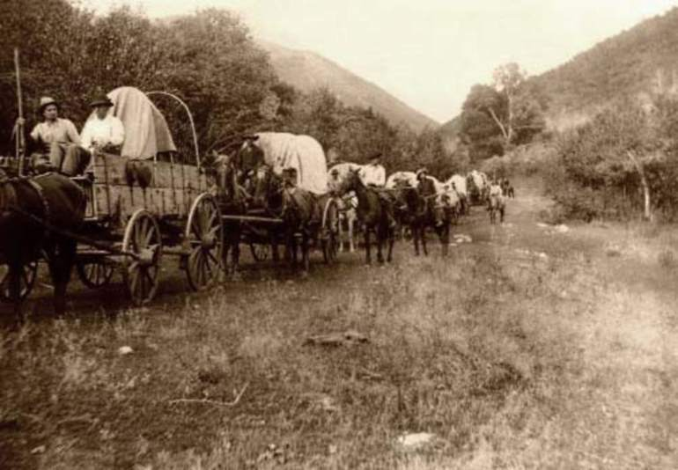
Westward Expansion
Why did people move from the East to the West?
32

Slide 34
Westward Expansion
Why did people move from the East to the West?
Opportunity
Adventure
33

Slide 35
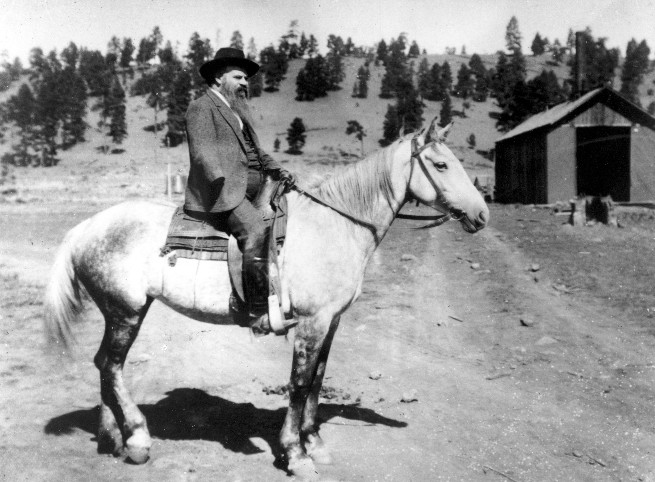
John Wesley Powell 1834 - 1902
First to lead an expedition down the Colorado River
34

Slide 36
John Wesley Powell 1834 - 1902
Civil War Soldier
Geologist
Explorer
35

Slide 37
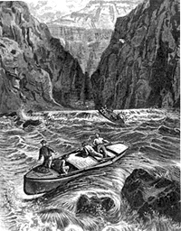
1st Expedition - 1869
What happened?
36

Slide 38
1st Expedition - 1869
What happened?
Water was rough
Rapids were unexpected
Length of the river was unknown
37

Slide 39
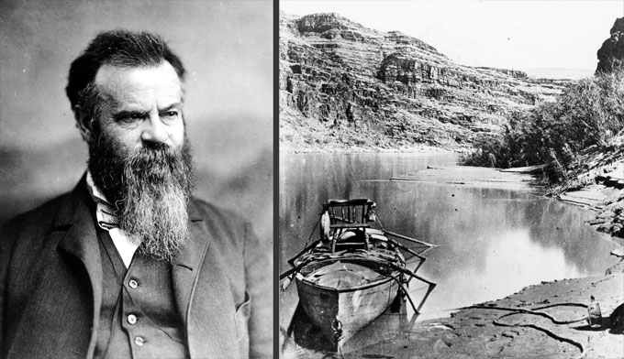
2nd Expedition 1871 - 1872
38

Slide 40
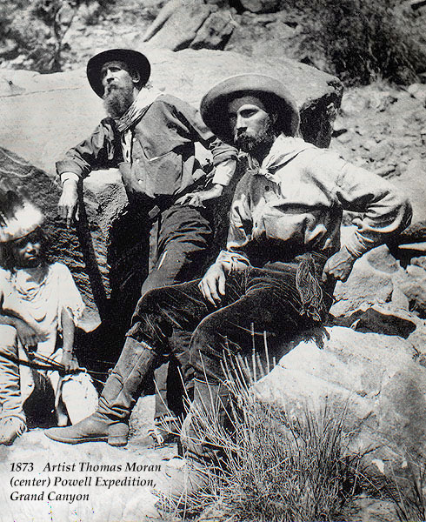
2nd Expedition
Who did Powell take with him?
Artist Thomas Moran
Map maker
Writer
Geologists
39

Slide 41
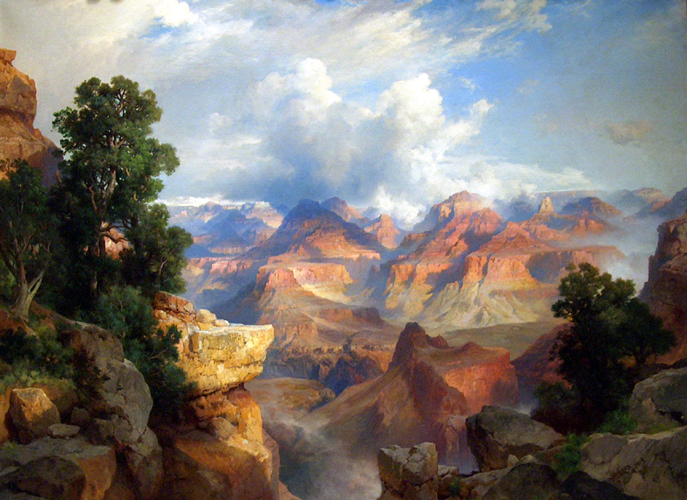
Thomas Moran, Artist of the Grand Canyon
40

Slide 42
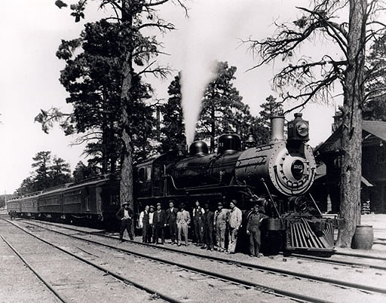
Traveling the Grand Canyon
1901
The railroad reached the Grand Canyon!
41

Slide 43
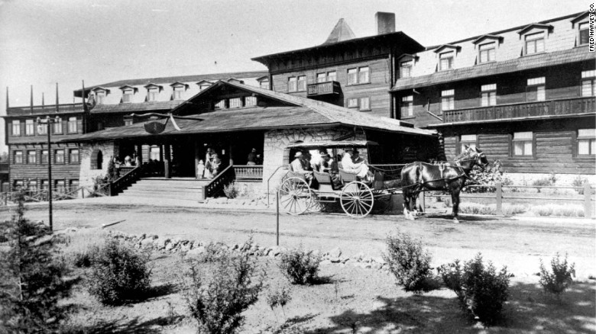
Fred Harvey & The Harvey Girls
Built hotels & lodges near railroad stations
42

Slide 44
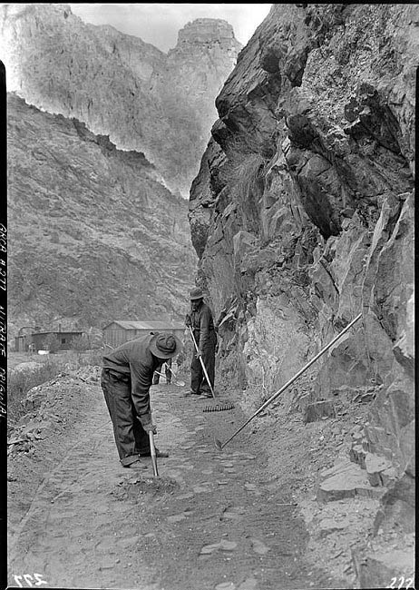
The WPA - Civil Conservation Corps
Six years
Trails
Rock walls
Camp grounds
Fences
Fire fighting
Visitor center
43

Slide 45
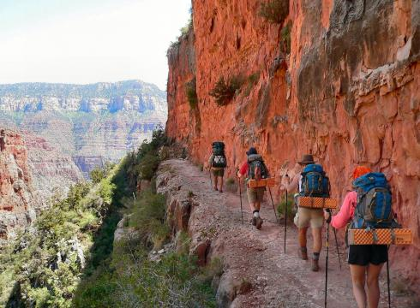
Visiting the Grand Canyon - Hiking
44

Slide 46
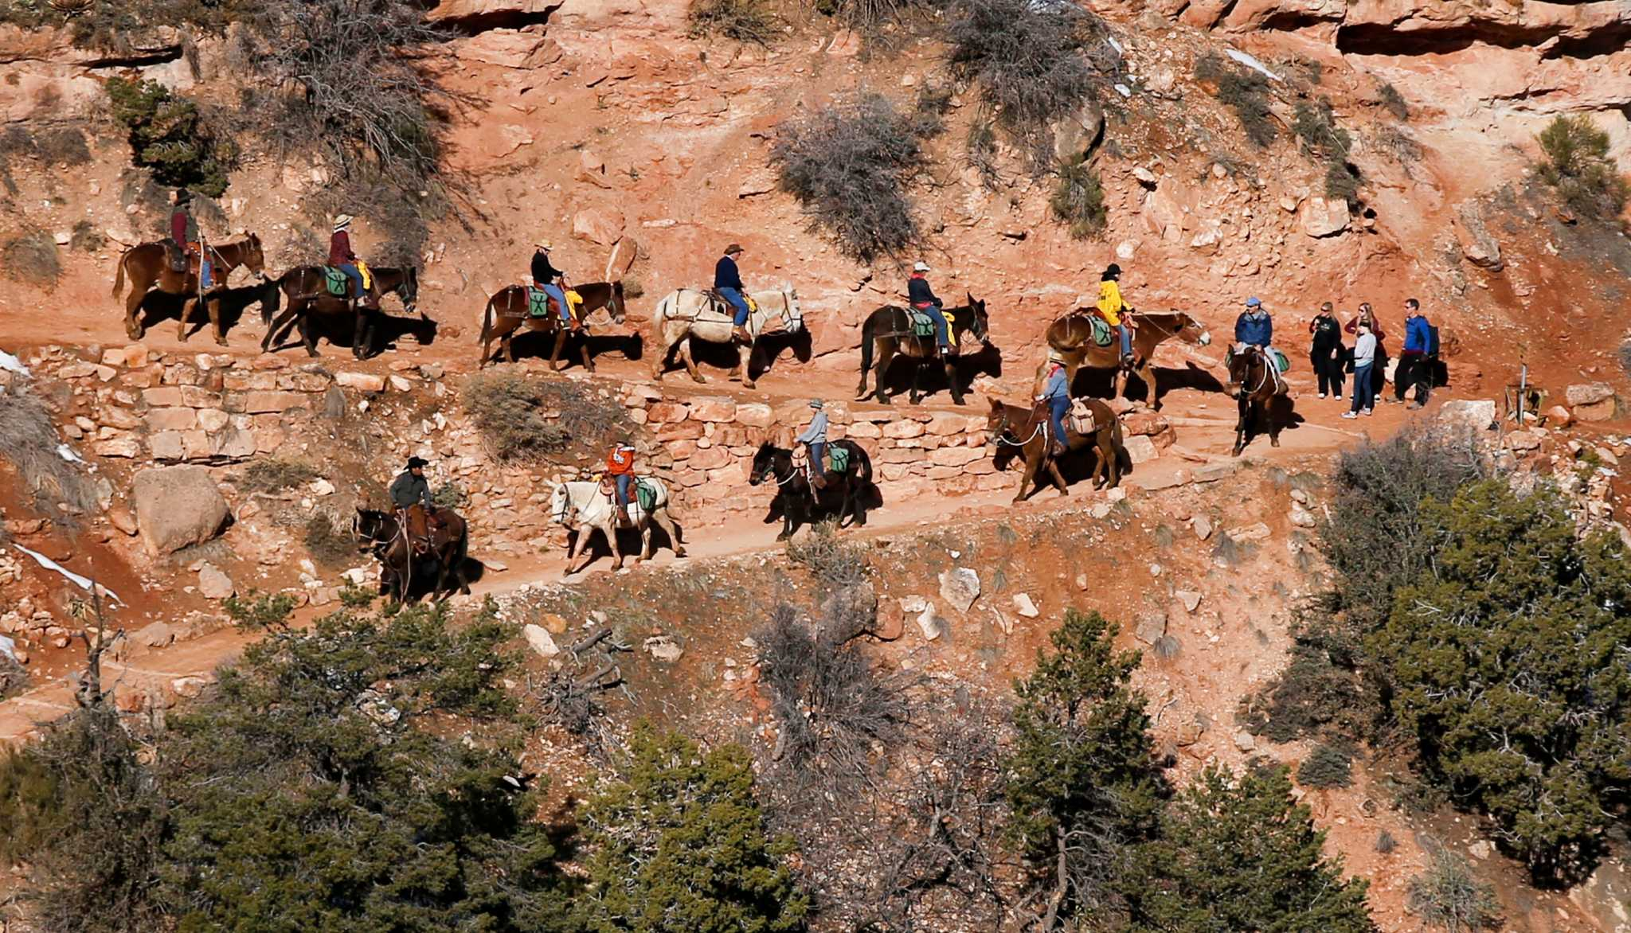
Mule Train
45

Slide 47
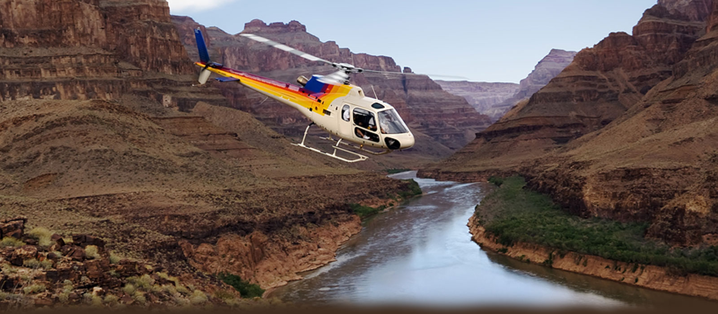
Helicopter
46

Slide 48
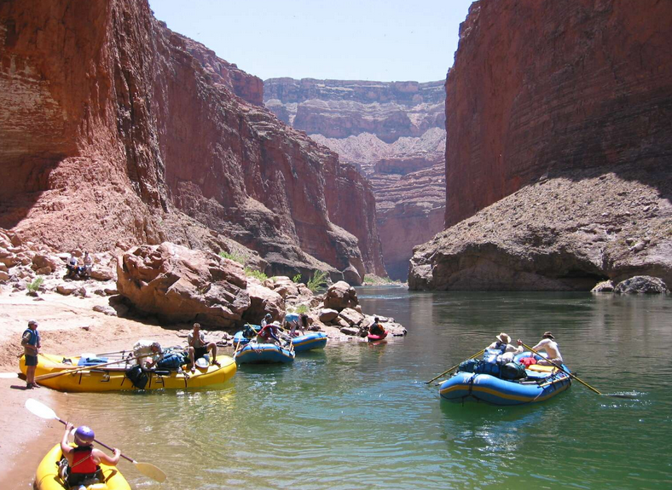
River Rafting
47

Slide 49
The Grand Canyon
48

