Slide 1
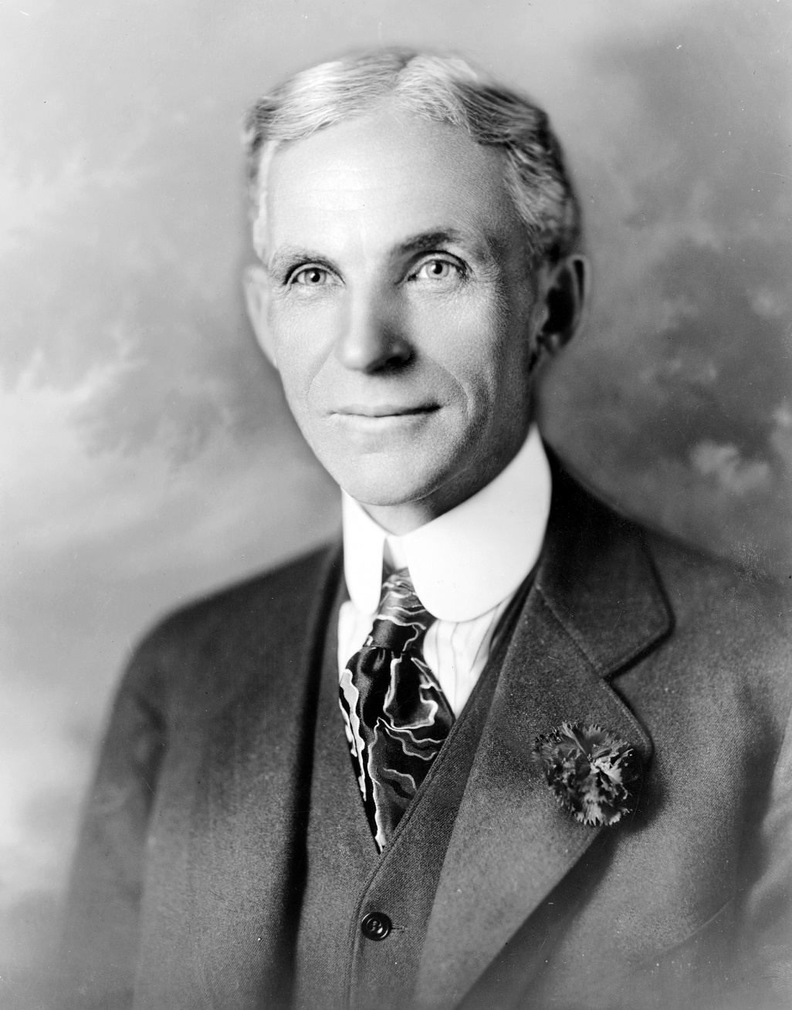
Henry Ford
1863 - 1947

Slide 2
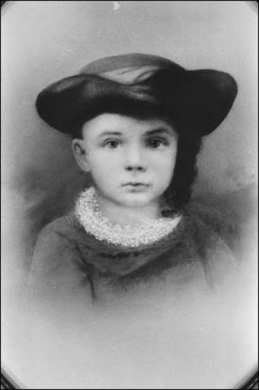
Henry Ford
Henry Ford was born in 1863 in Dearborn Michigan
Henry was a curious child
Henry liked to put things together and take them apart
1

Slide 3
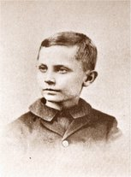
Henry Ford
What kinds of mechanical things did Henry like?
Farm equipment
Watches & clocks
2

Slide 4
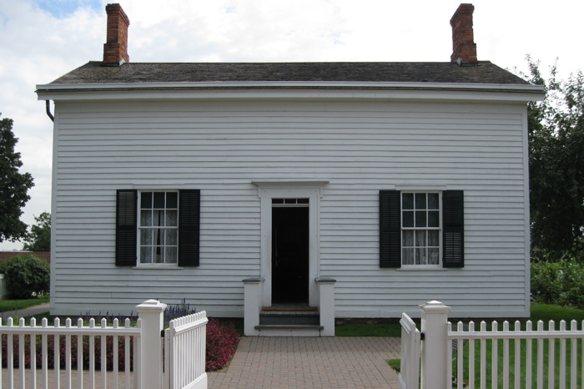
Henry Ford’s Childhood Home
Henry didn’t want to stay on the farm so he moved to Detroit.
3

Slide 5
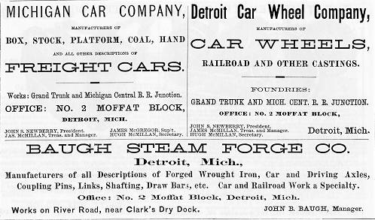
Henry Ford’s First Job
His first job was working on railroad cars. Why do you think he liked railroad cars?
The cars were mechanical
The cars moved
4

Slide 6
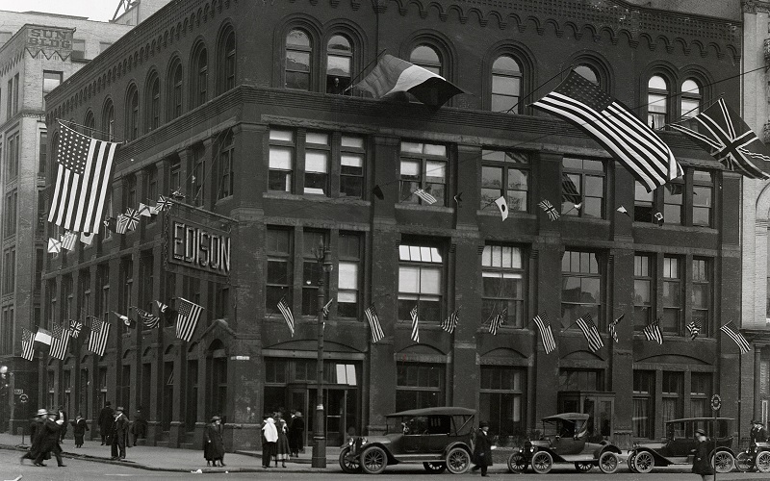
1891 – Edison Illumination Company
Henry’s second job was at the Edison Light Company.
5

Slide 7
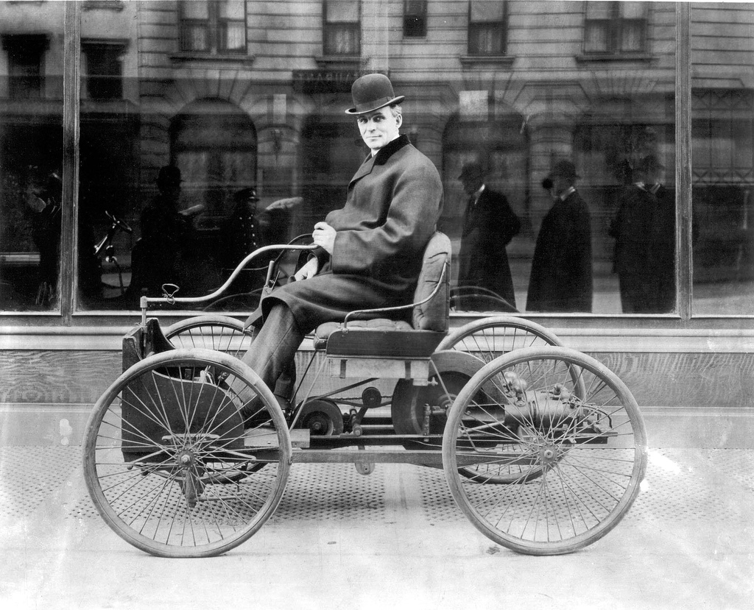
1896 – The Quadra Cycle
Tiller steering
Gasoline powered engine
Two speeds
No reverse
6

Slide 8
1903 – The Ford Motor Company
Ford’s first factory
7

Slide 9
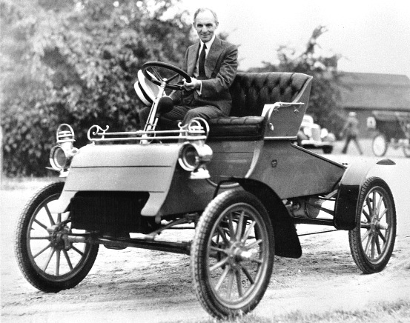
1903 – The Model T
Two people
No roof
Small gas tanks
Lantern lights
8

Slide 10
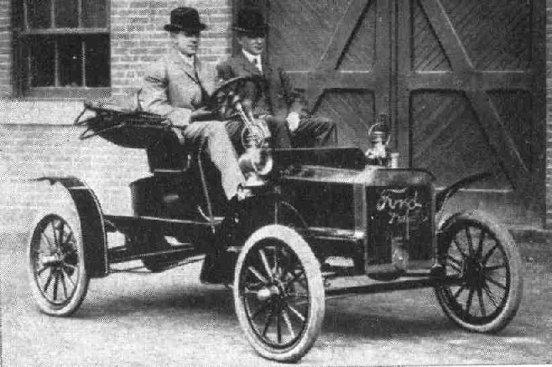
1907 – The Model N
9

Slide 11
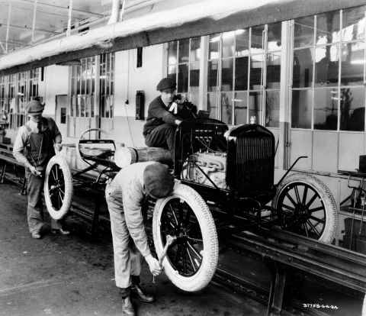
The Assembly Line
What other industries used an assembly line?
Candy makers
Watch makers
10

Slide 12
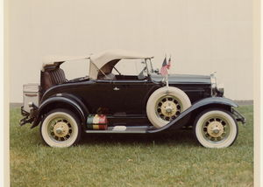
1927 Ford Model A
The most popular car of all!
11

Slide 13
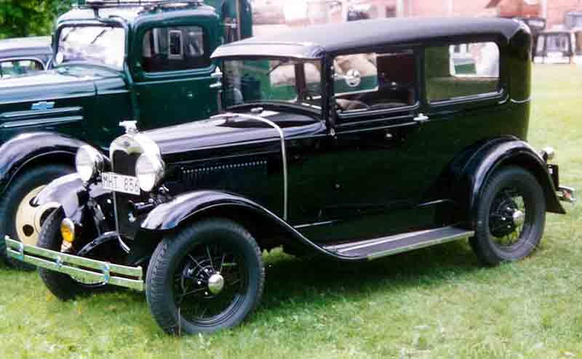
1930 Ford Model A
12

Slide 14
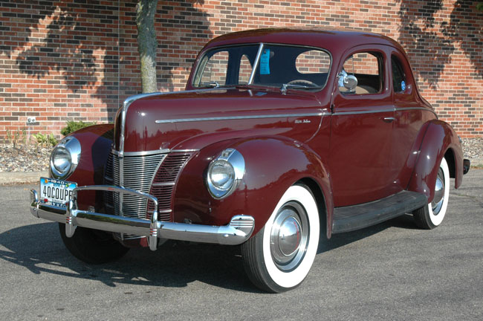
1940 Ford
13

Slide 15
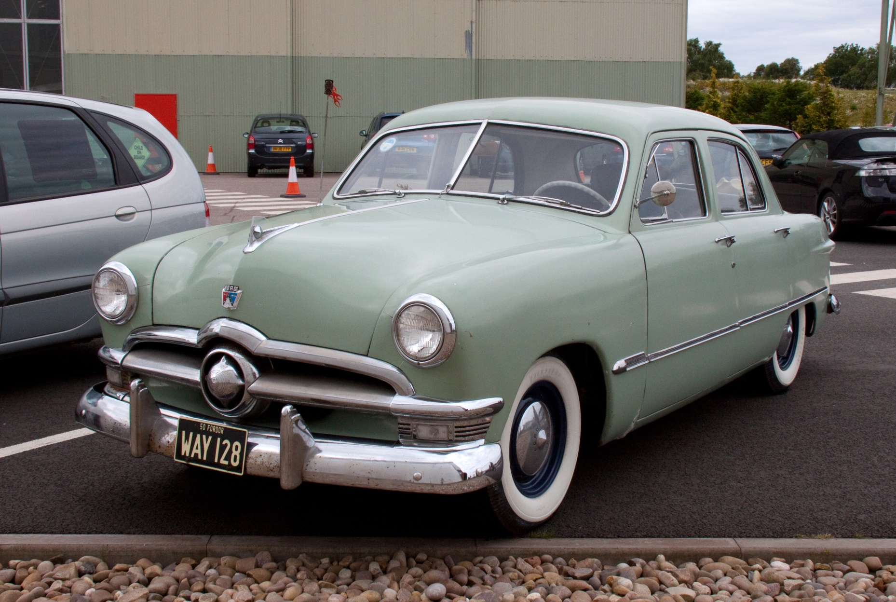
1950 Ford
14

Slide 16
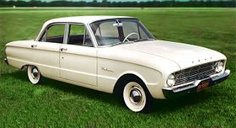
1960 Ford Falcon
15

Slide 17
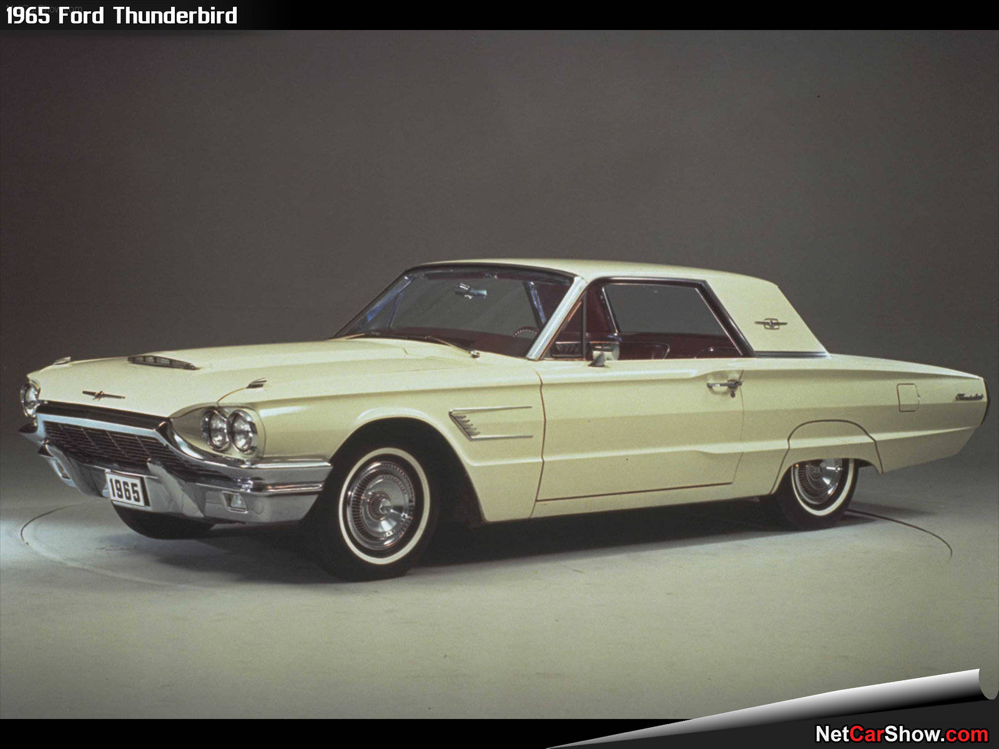
1965 Ford Thunderbird
16

Slide 18
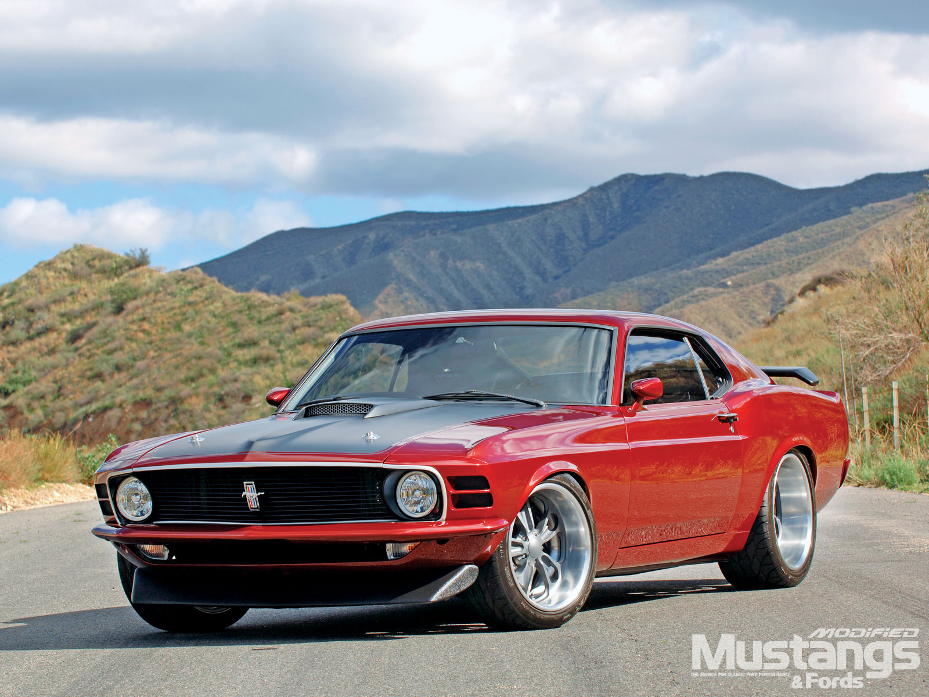
1970 Ford Mustang
17

Slide 19
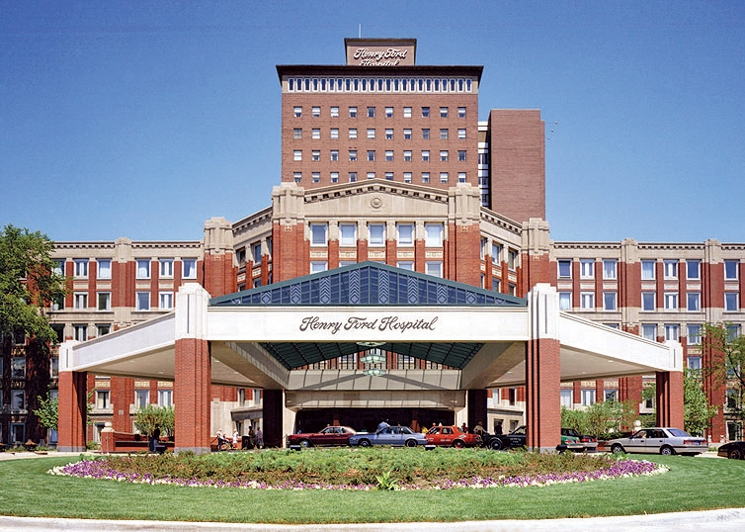
Henry Ford Hospital
Henry Ford was a philanthropist. He gave much of his money away.
18

Slide 20
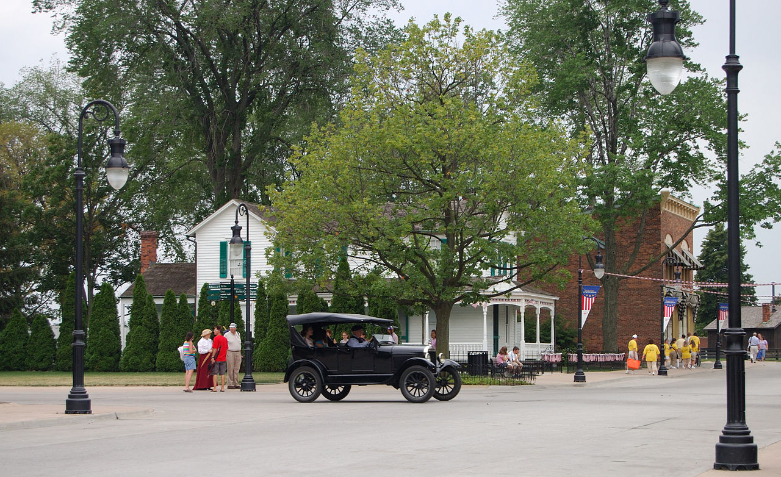
Greenfield Village, MI - 1929
The Henry Ford Living Museum
19

Slide 21
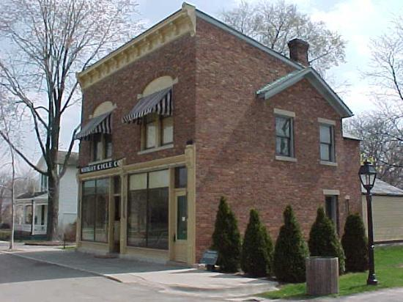
Greenfield Village, MI - 1929
The Wright Brothers Bicycle Shop
20

Slide 22
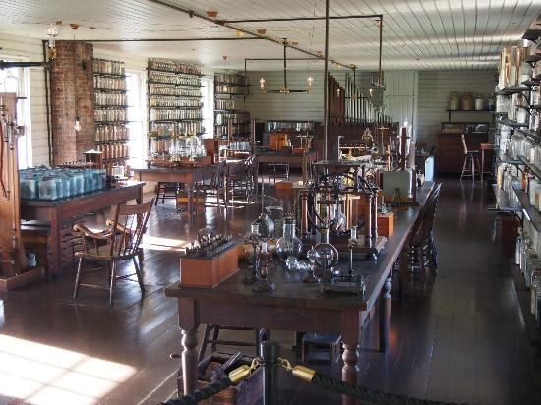
Greenfield Village, MI - 1929
Thomas Edison’s laboratory
21

Slide 23
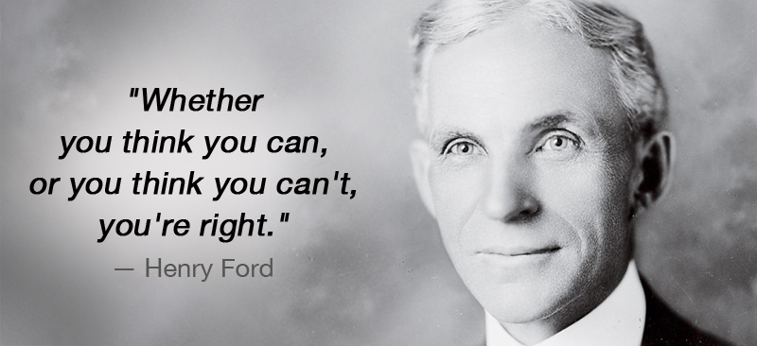
21

Slide 24
Henry Ford
1863 - 1947
22

