Slide 1
I Spy
America’s Spies

Slide 2
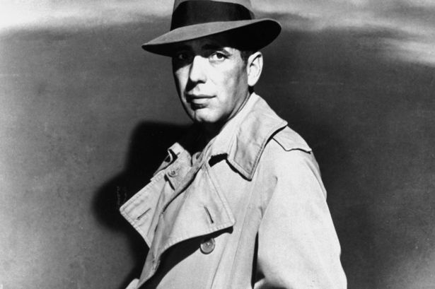
Famous Movie Spies
Humphrey Bogart
Across the Pacific
1942
1

Slide 3
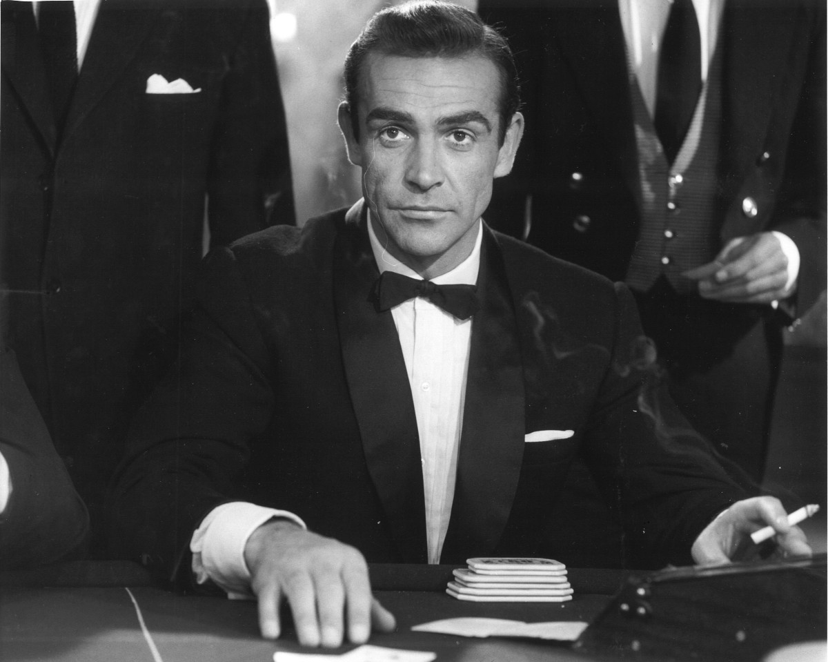
Famous Movie Spies
Sean Connery
James Bond
007
2

Slide 4
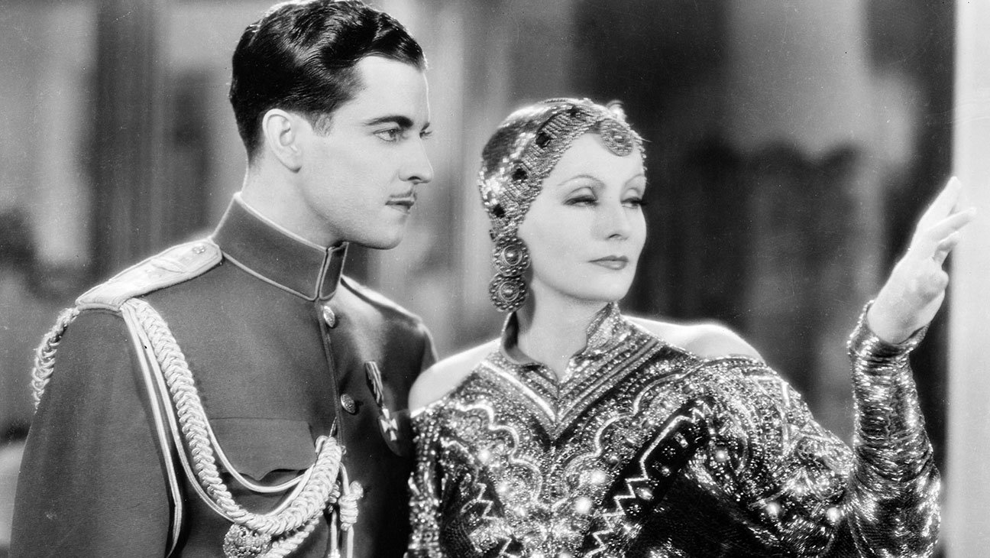
Famous Movie Spies
Mata Hari
World War 1
Sexy and seductive
03

Slide 5
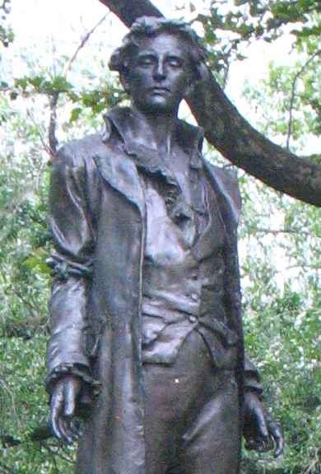
America’s Most Famous Spy
Nathan Hale
1755 - 1776
“I regret that I only have one life to give for my country.”
4

Slide 6
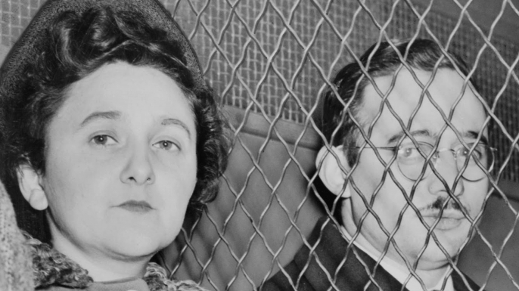
Famous Spies – Julius & Ethel Rosenberg
Convicted of giving Russia information about America’s nuclear weapon program
Executed 1953
5

Slide 7
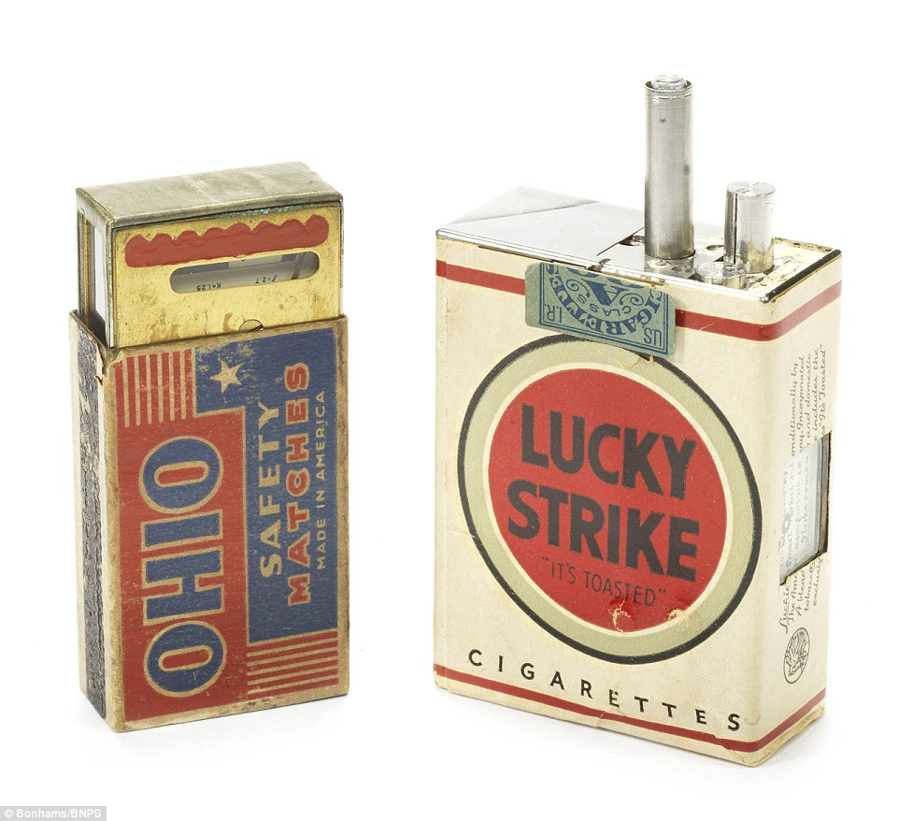
Spy Stuff
Tape recorder
Camera
Ordinary items
Miniature
Concealed
6

Slide 8
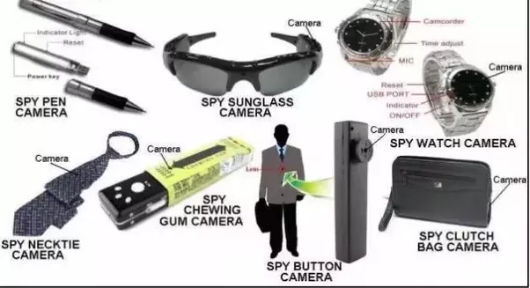
More Spy Stuff
7

Slide 9
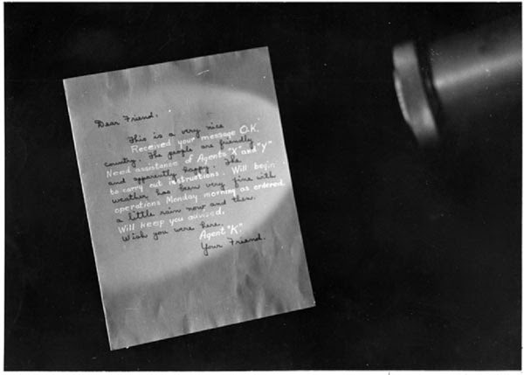
The Concealed Messages of Spies
Lemon juice
Invisible ink
Bright light
8

Slide 10
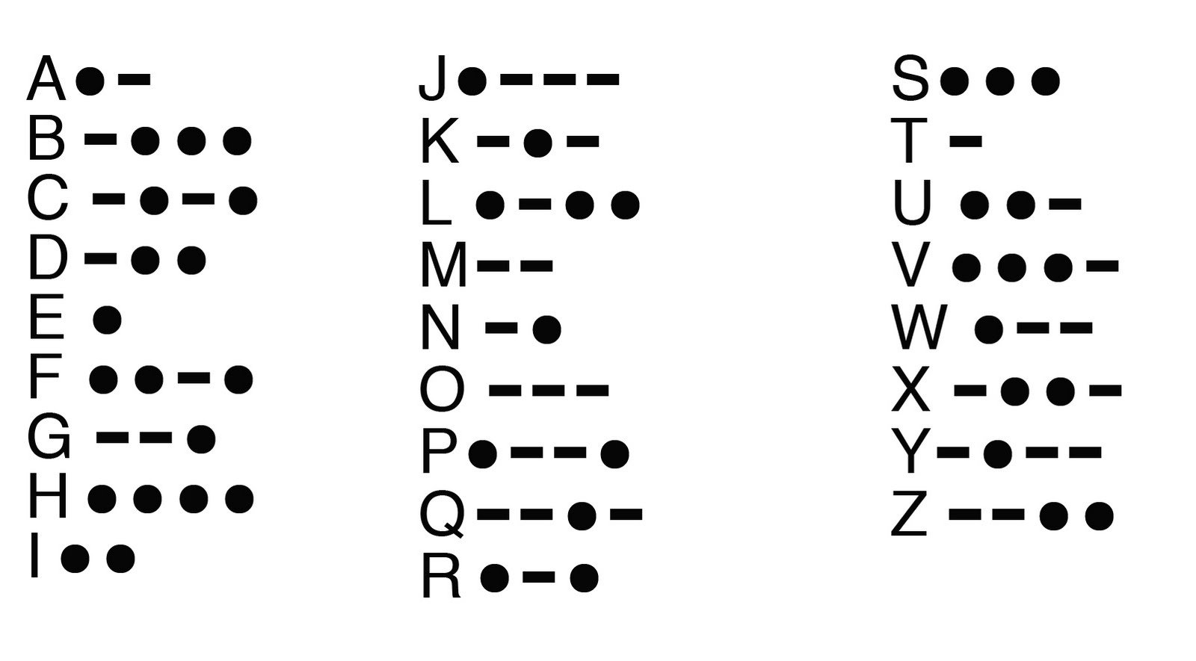
Morse Code
Code
Useful, not very secret
9

Slide 11
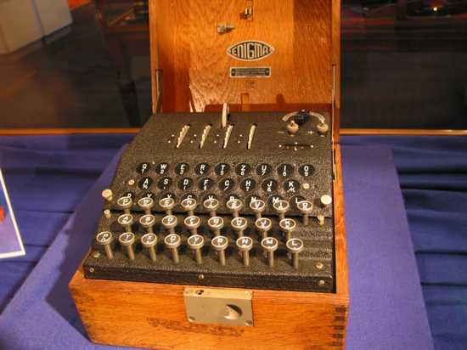
Enigma Code
German Invention
Billions of possible settings
US and UK broke the code with the invention of the computer
10

Slide 12
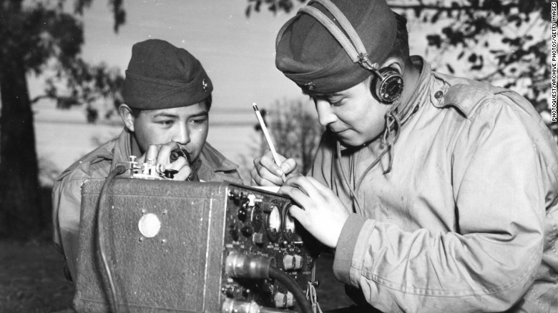
Indian Code Talkers
33 Tribes
Spoken languages
The enemy could not break
Iwo Jima
10

Slide 13
Using Computers to Spy
cy·ber·war
the use of computer technology to disrupt the activities of a state or organization, especially the deliberate attacking of information systems for strategic or military purposes
"cyberwar is asymmetric, which means it benefits lesser military powers as much as military goliaths"
12

Slide 14
What would a Cyber War look like?
Hacked Websites
Anyone who visits a particular website could have a virus or demon installed on their computer
The hacker can change the programs: GPS can be redirected so soldiers are sent to the wrong area
Hackers can effect critical infrastructure: shut down the electrical system
13

Slide 15
What do spies wear?
A hat protects the spy from weather and also from being easily recognized
Trench coat protects the spy from the weather and provides lots of pockets
14

Slide 16
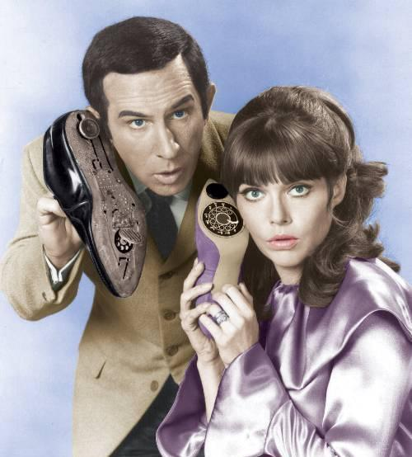
Famous TV Spies
“Get Smart”
Maxwell Smart was a bumbling secret agent
Agent 99 was always there to bail him out
Telephones in their shoes, really?
15

Slide 17
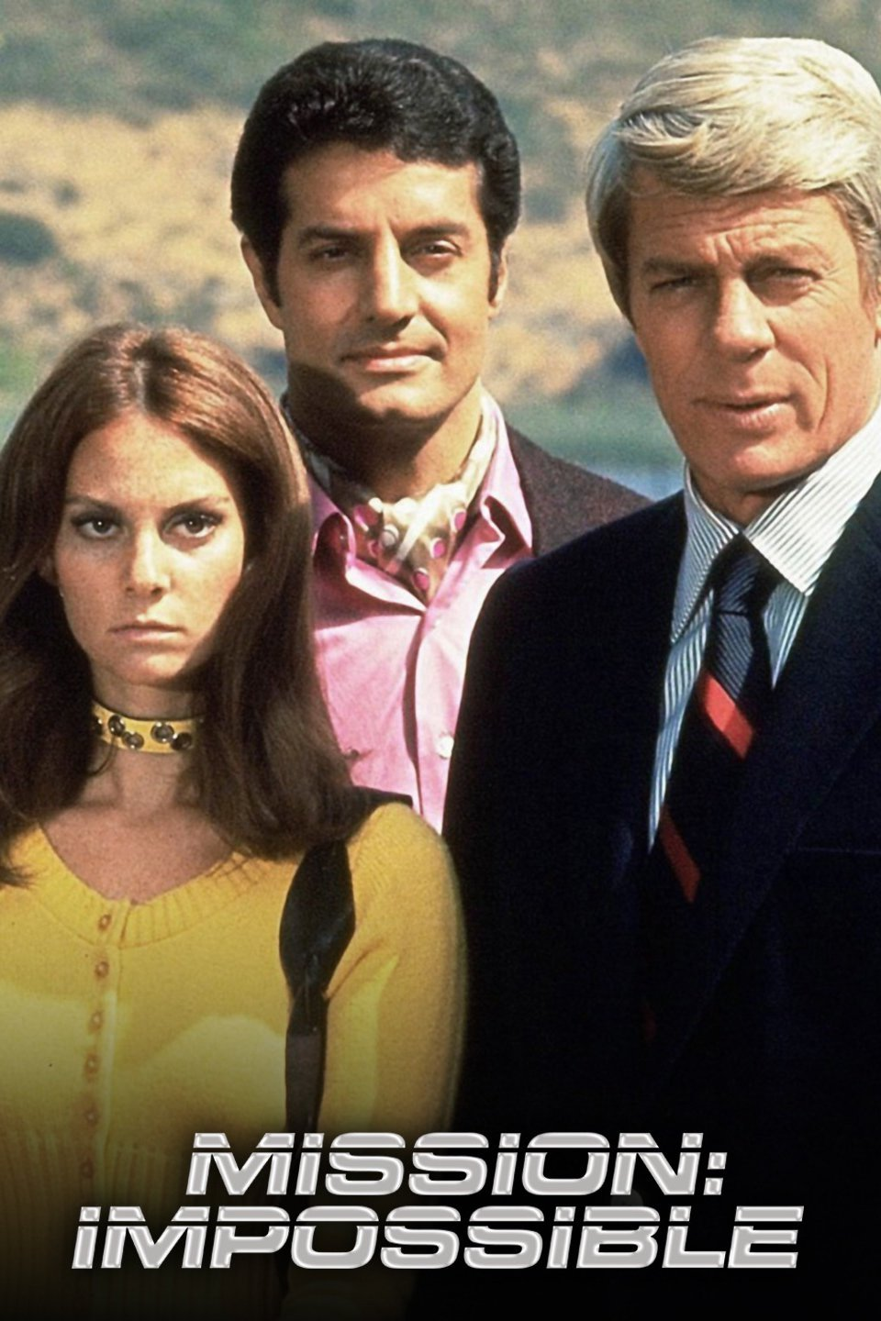
Famous TV Spies
“Mission Impossible”
Worked for the US government’s secret program called the “Impossible Mission Force”
Covert (undercover) secret missions against dictators, evil governments and crime lords
16

Slide 18
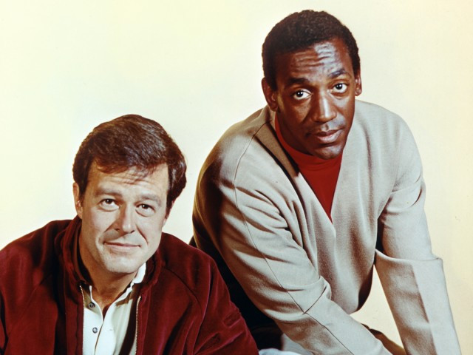
Famous TV Spies
“I Spy”
A pair of spies posing as a professional tennis player and his coach
Spies for the Pentagon
17

Slide 19
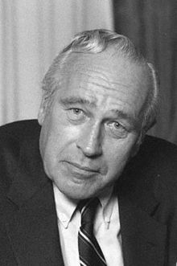
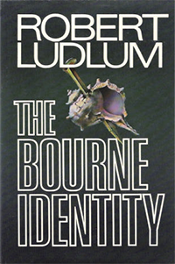
Spy Writers
Robert Ludlum
18

Slide 20
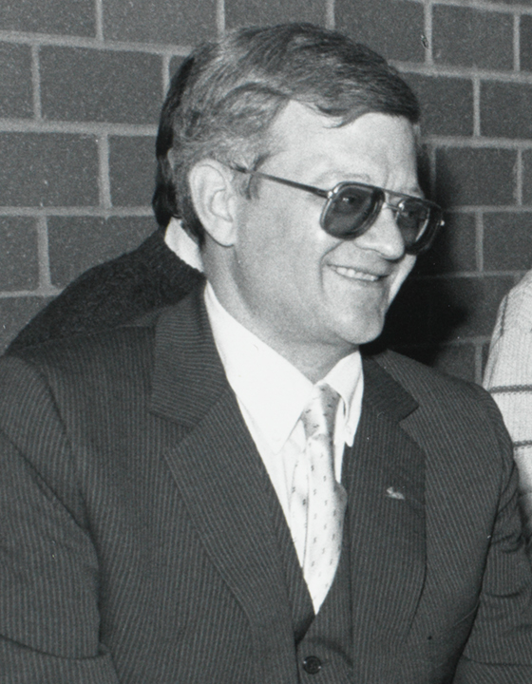
Spy Writers
Tom Clancy
19

Slide 21
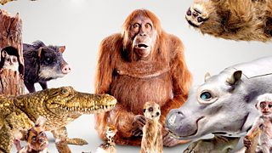
Spy in the Wild
PBS Nature Series
Animal robots with cameras spying on animals in the wild
20
http://www.pbs.org/wnet/nature/spy-in-the-wild-about/14810/

