Slide 1
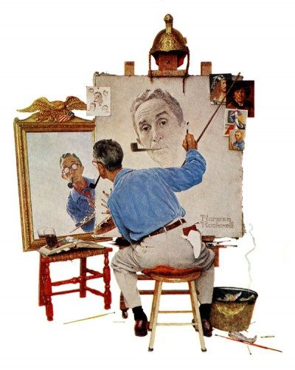
Norman Rockwell
Who was Norman Rockwell?
0

Slide 2
Norman Rockwell 1894 - 1978
Who was Norman Rockwell?
Painter
Illustrator
Writer
1

Slide 3
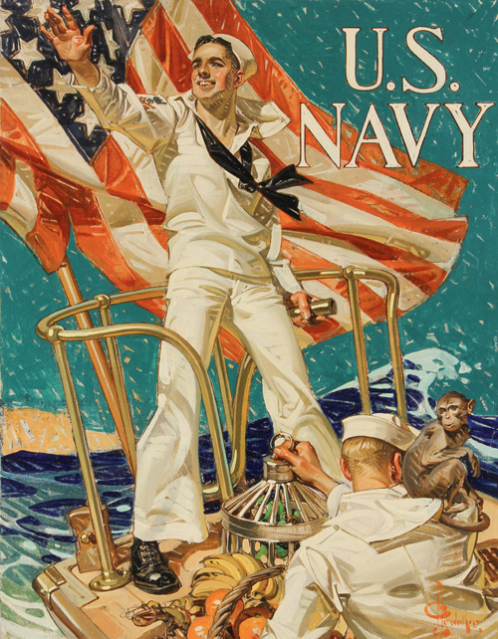
Rockwell Joined the Navy
Served as an Illustrator for a Navy Publication
Afloat and Ashore
2

Slide 4
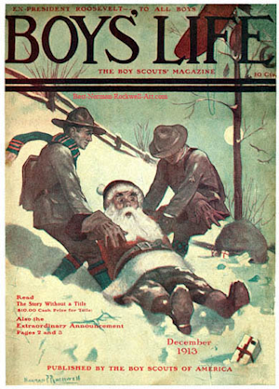
Rockwell’s First Magazine Cover
Christmas Cover
1913
3

Slide 5
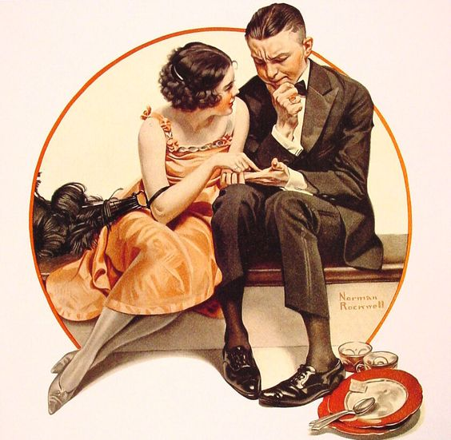
Rockwell Used Models
In the beginning he sketched the models and then converted the sketch to a painting.
4

Slide 6
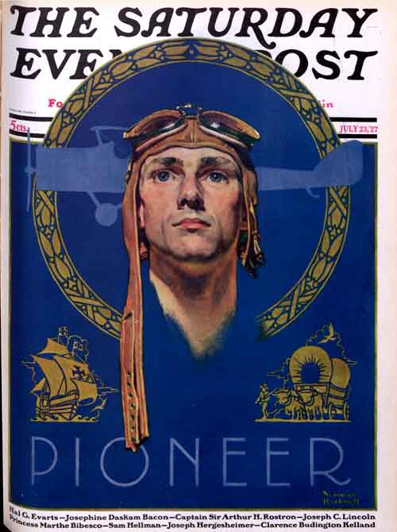
Cover Celebrating Lindbergh’s Famous Flight
1927
Celebration of Charles Lindbergh's crossing of the Atlantic
5

Slide 7
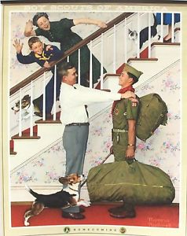
Illustrations for the Boy Scouts
6
What do you see in these illustrations?

Slide 8
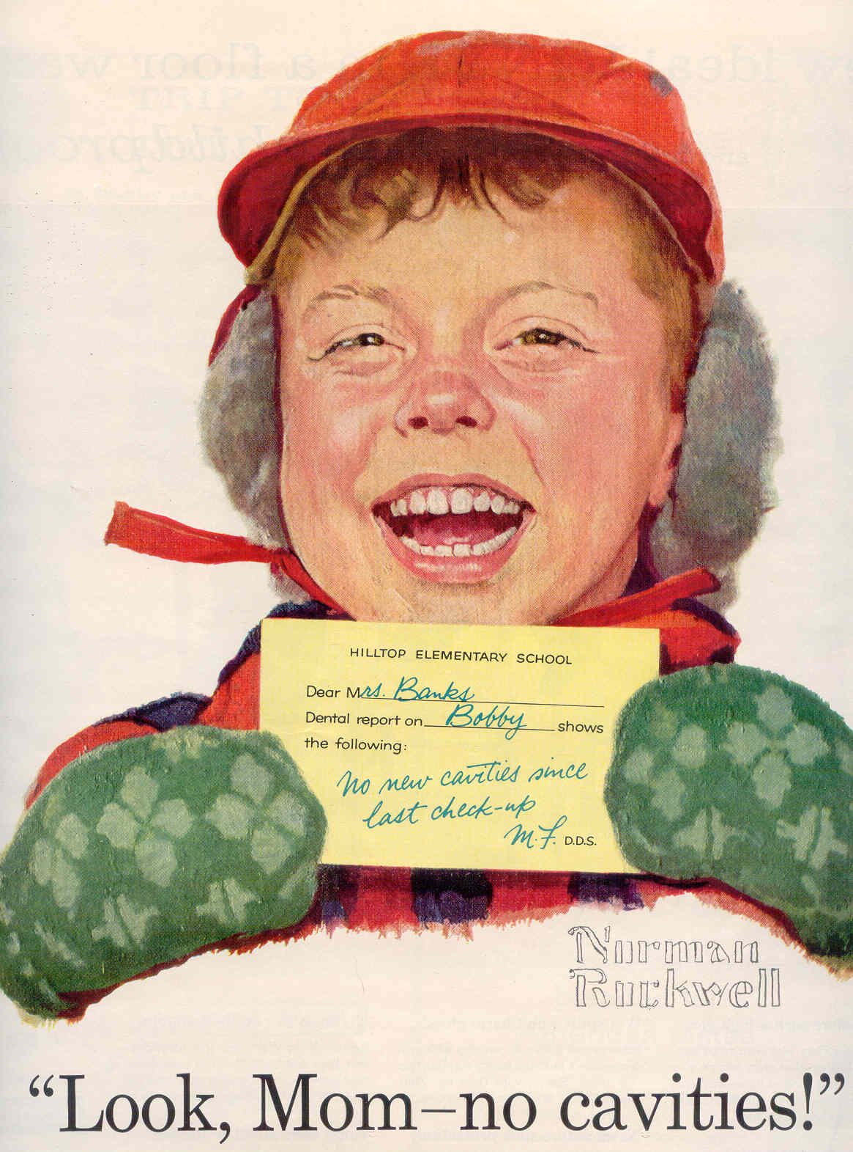
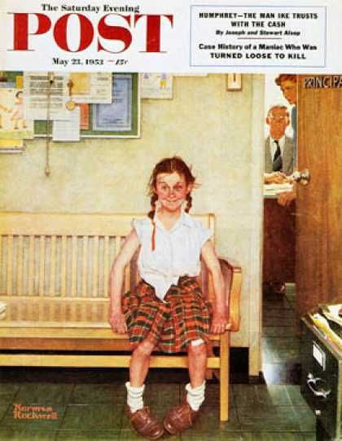
American Children
7
What do you see in these illustrations?

Slide 9
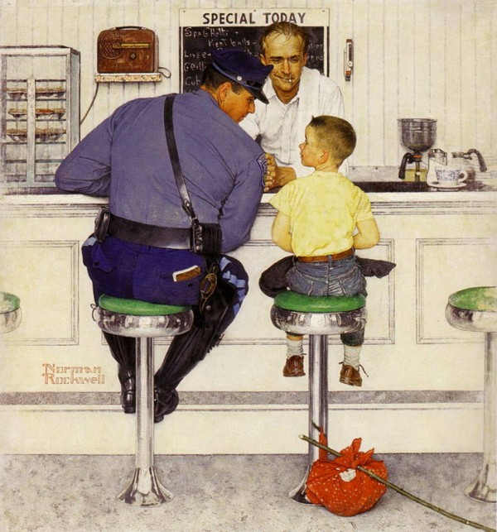
American Children
Where did Rockwell find his models?
8

Slide 10
American Children
Where did Rockwell find his models?
In his hometown; he used ordinary people.
9

Slide 11
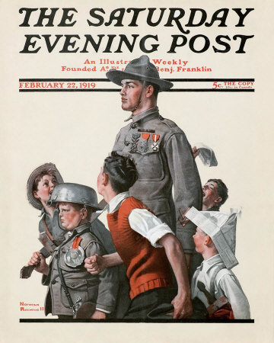
American Children
What do you see in this illustration?
10

Slide 12
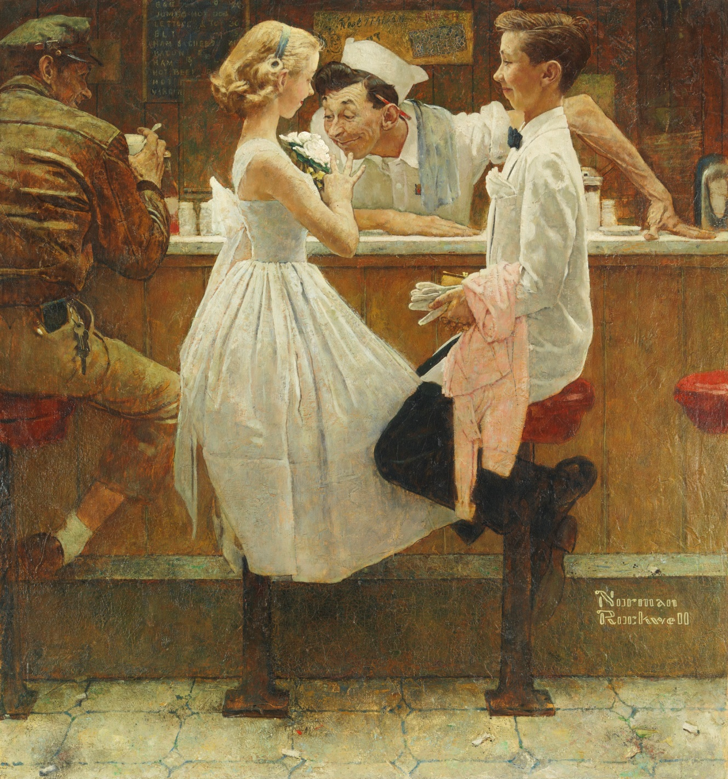
After the Prom (1957)
What do you see in this illustration?
11

Slide 13
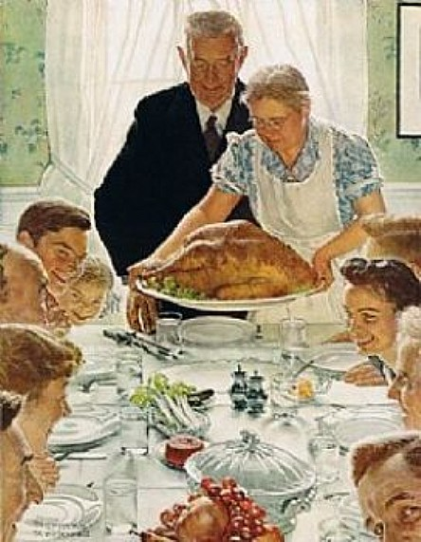
American Holidays
An
American Thanksgiving
12

Slide 14
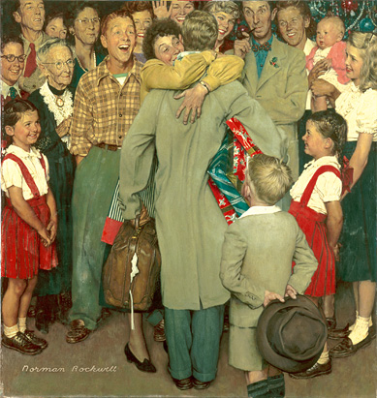
American Holidays
An
American Christmas
13

Slide 15
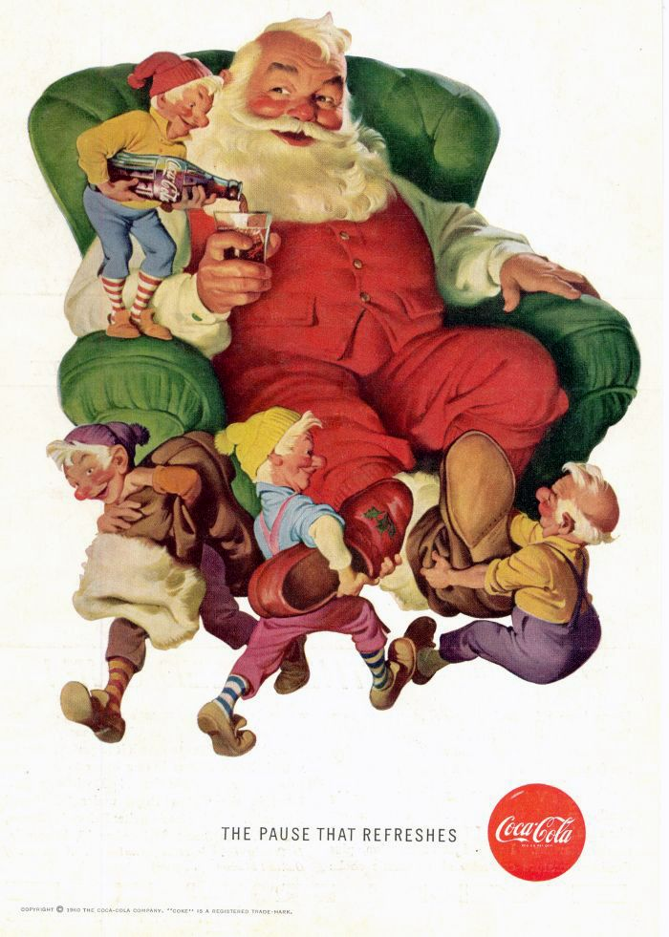
Christmas Advertisement for Coca-Cola
14

Slide 16
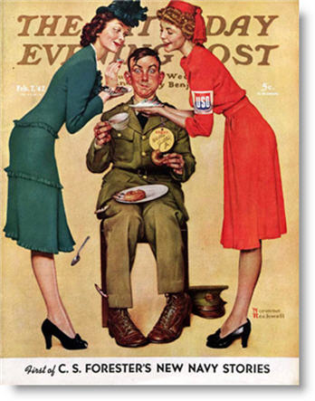
Rockwell was very patriotic and very supportive of the military.
15

Slide 17
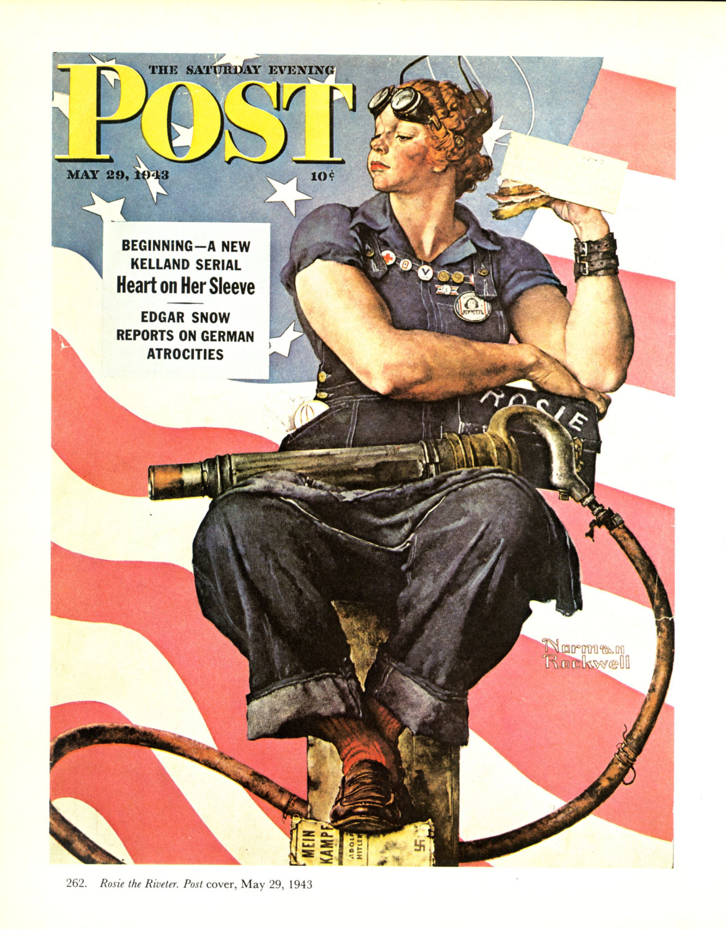
Military
Rosie the Riveter
16

Slide 18
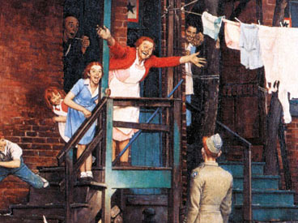
Military
This painting is titled “The Red Heads.” Any idea why?
17

Slide 19
Military
This painting is titled “The Red Heads.” Any idea why?
The family all have red hair, including the soldier.
18

Slide 20
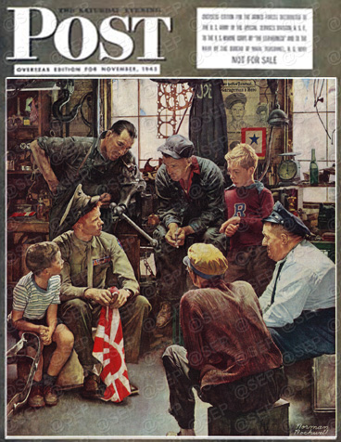
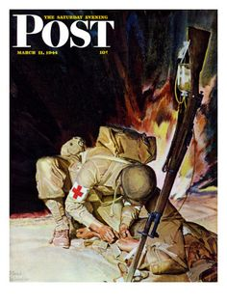
Military
19

Slide 21
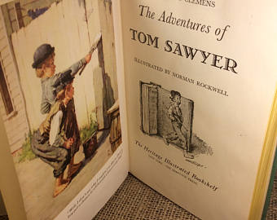
Norman Rockwell was a book illustrator
20

Slide 22
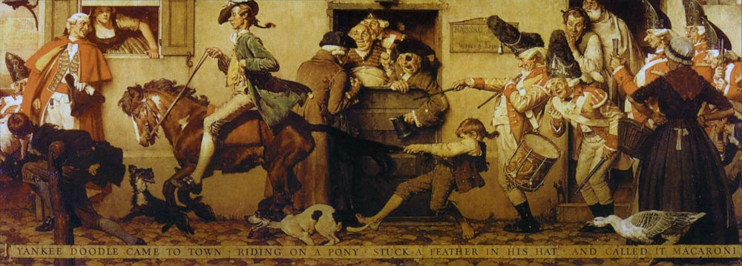
Norman Rockwell painted murals
21

Slide 23
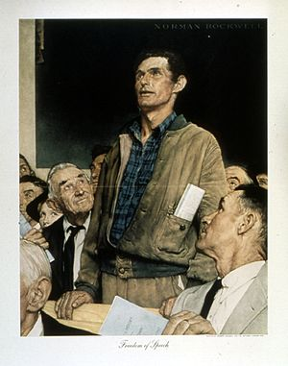
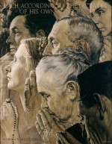
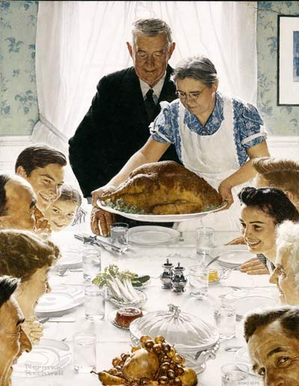
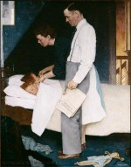
Rockwell’s Four Freedoms
These paintings were inspired by President Roosevelt’s famous “Four Freedom’s” speech.
22

Slide 24
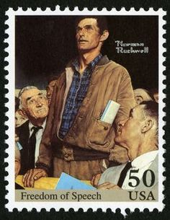
Freedom of Speech
23

Slide 25
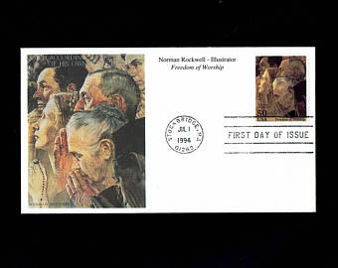
Freedom of Worship
24

Slide 26
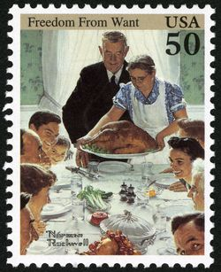
Freedom from Want
25

Slide 27
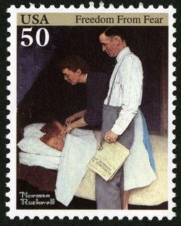
Freedom from Fear
26

Slide 28
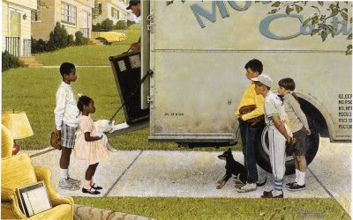
Social Issues – Civil Rights
What story do you think Rockwell was telling with this painting?
27

Slide 29
Social Issues – Civil Rights
What story do you think Rockwell was telling with this painting?
The children are different and they are the same.
28

Slide 30
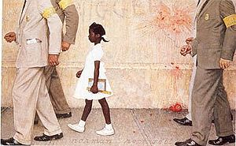
Rockwell in the 1960’s
29

Slide 31
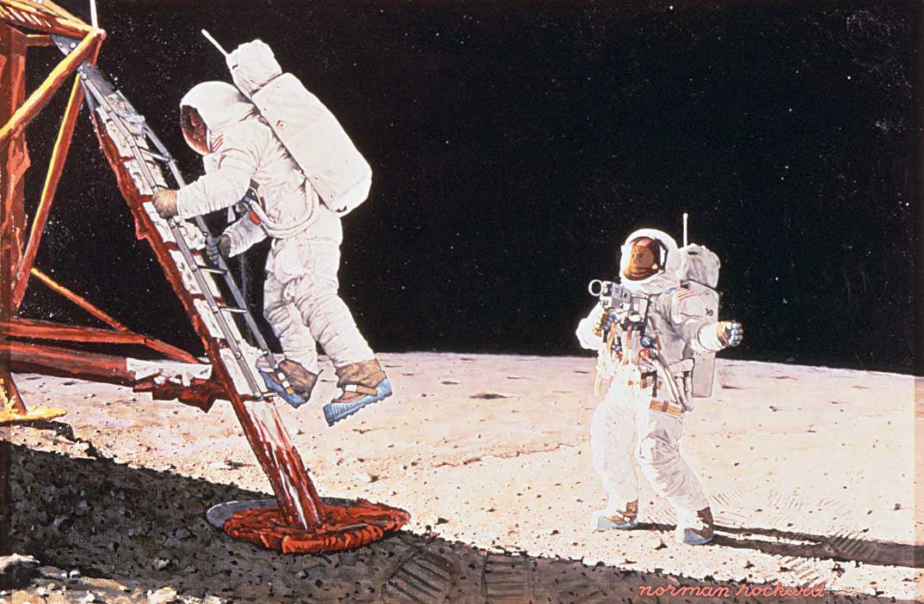
America Landing on the Moon
30

Slide 32
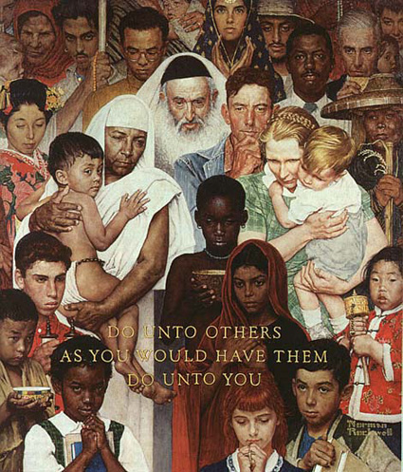
“Do unto others as you would have them do unto you.”
31

Slide 33
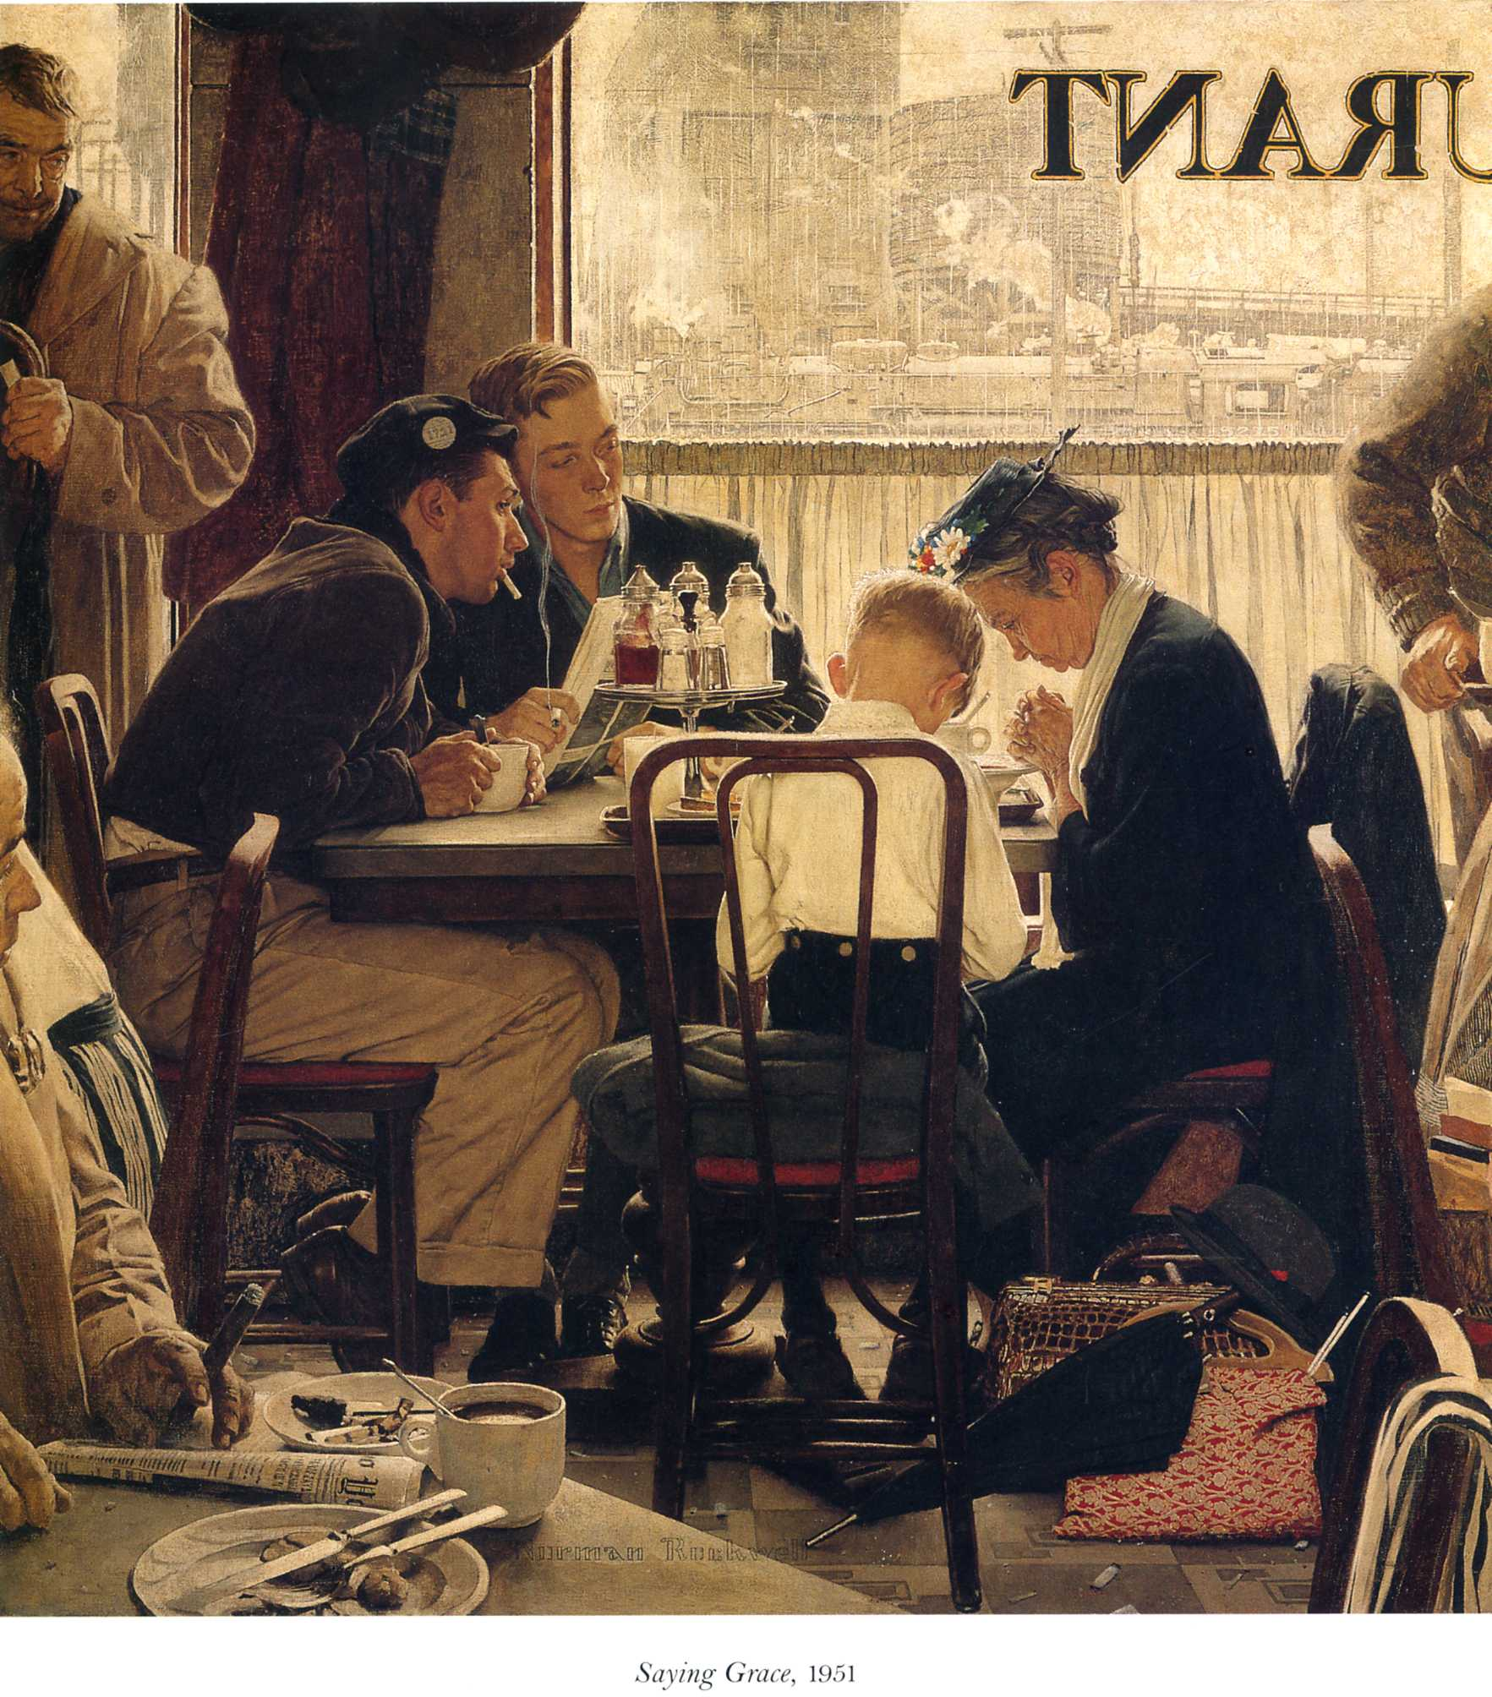
“Saying Grace”
Sold in 2013
$46,000,000
32

Slide 34
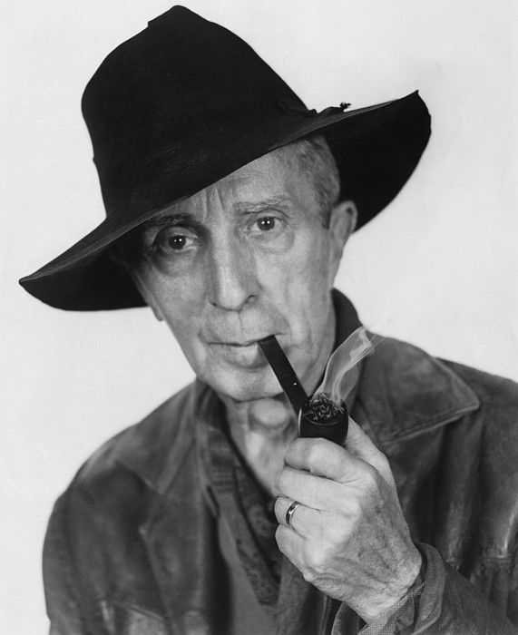
Norman Rockwell
“America’s Artist”
33

