Slide 1
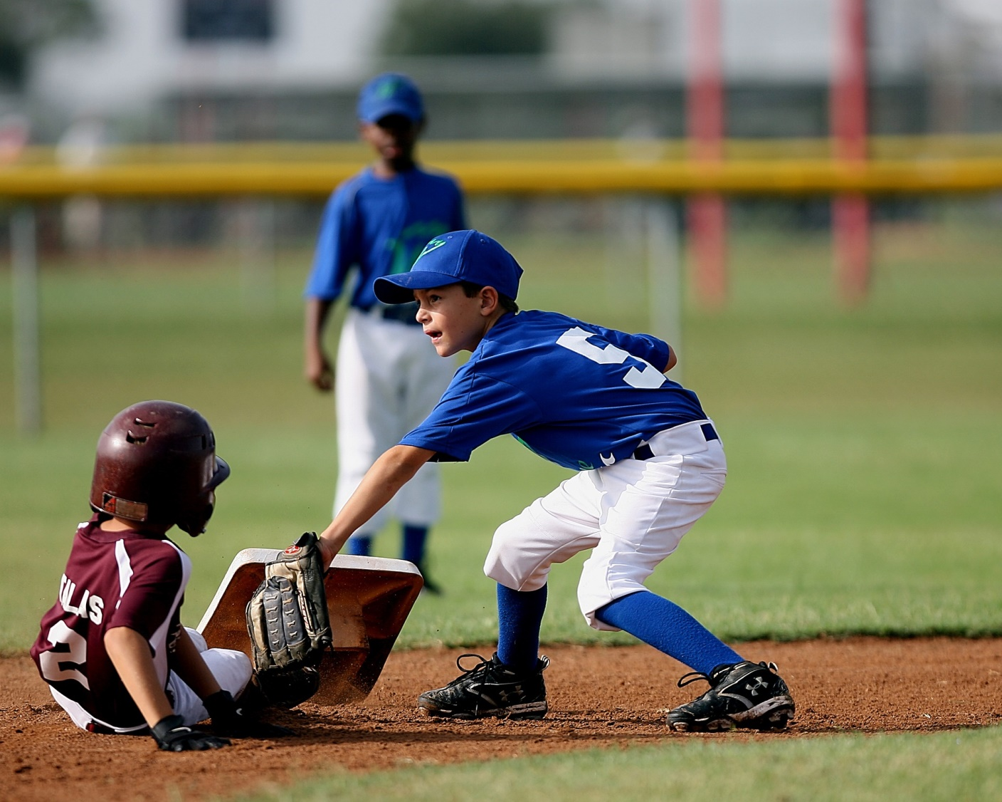
Take Me Out to the Ballgame!

Slide 2
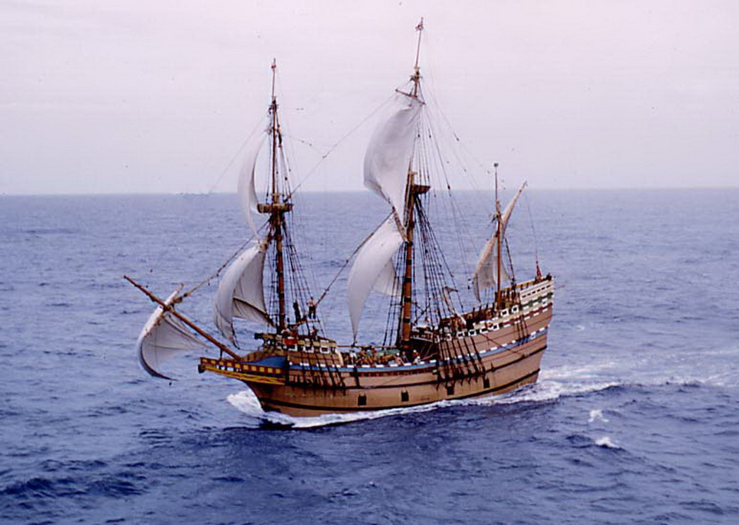
How did baseball arrive in America?
The Mayflower
A game called “rounder's” was played in England with a stick and a ball
1

Slide 3
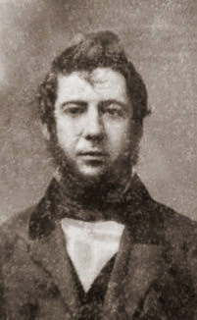
The First Rules - September 1845
Alexander Cartwright
Bank clerk
Volunteer firefighter
Created the rules
Organized a team
2

Slide 4
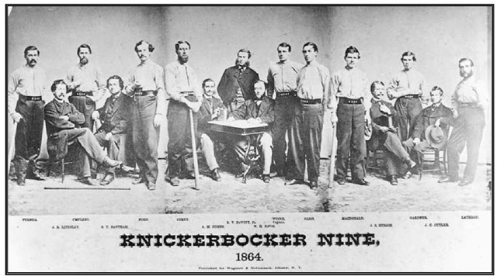
The First Baseball Team
The New York
Knickerbockers
3

Slide 5
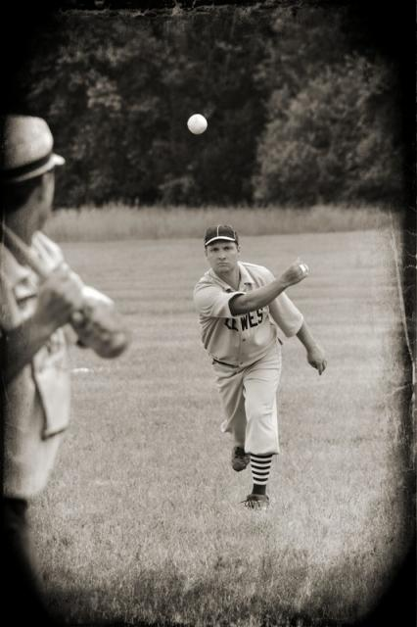
Alexander’s Rules of Baseball 1845
Underhand Pitches
Only strikes counted
To get an “out” players threw balls at the runners
4

Slide 6
Alexander’s Rules of Baseball 1845
Not enough players? No problem, get someone from the stands
Teams could trade players anytime during the game
5

Slide 7
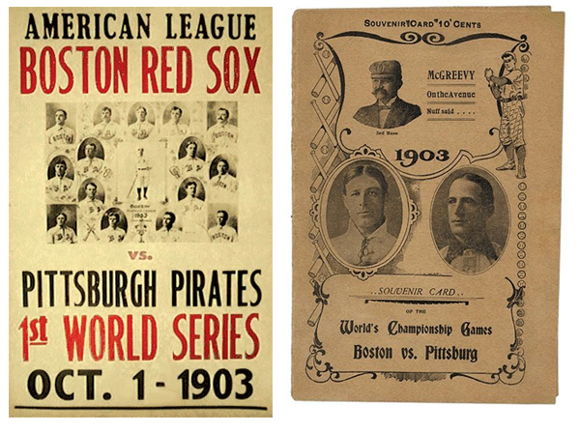
First World Series - 1903
National League (8 teams)
American League (8 teams)
Best of NINE games won (today is the best of seven)
6

Slide 8
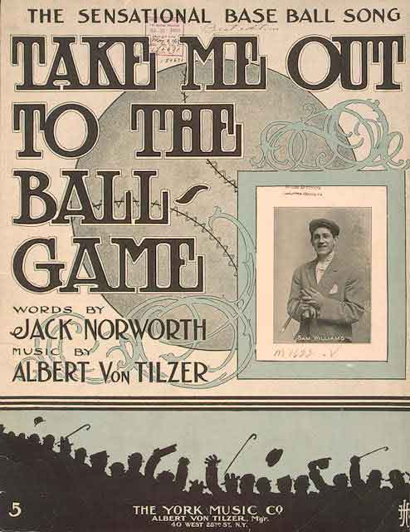
“Take Me Out to the Ball Game” - 1908
Let’s listen to “Take me Out to the Ballgame” from 1908
7
https://www.youtube.com/watch?v=q4-gsdLSSQ0

Slide 9
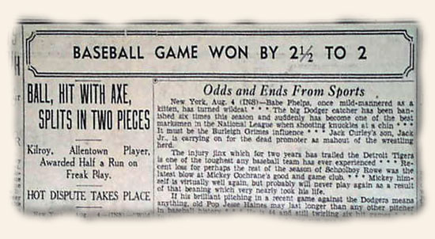
Baseball Before Radio
Q: How did you know if your team won?
A: You read it in the newspaper!
8

Slide 10
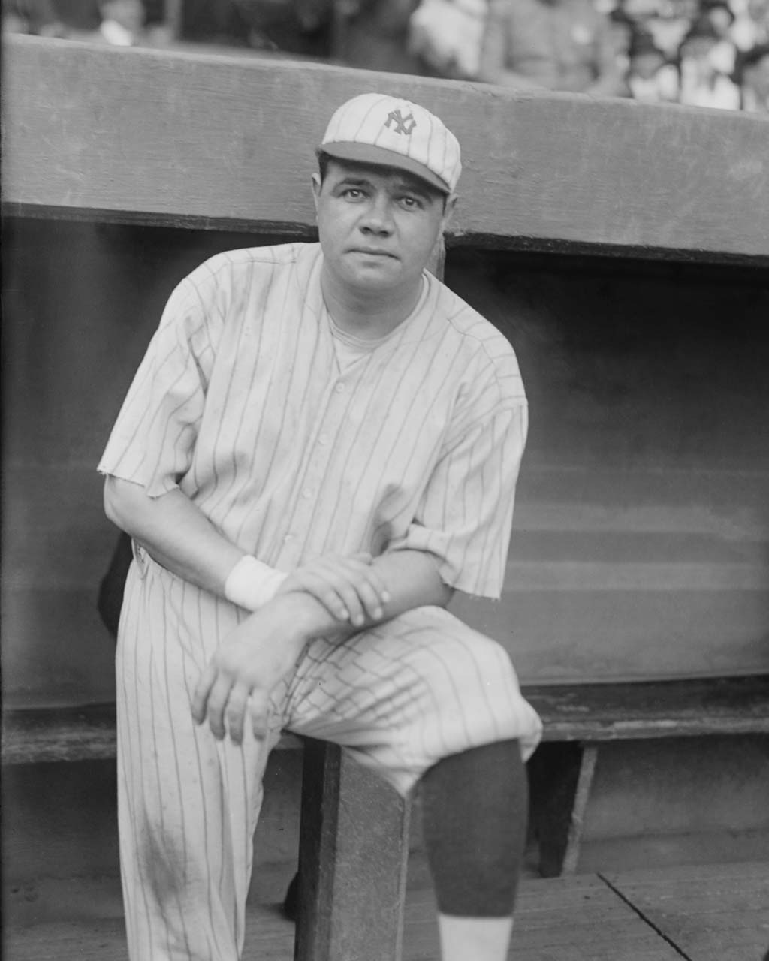
Baseball in the 1920’s
Babe Ruth
1895 - 1948
“he was a natural”
9

Slide 11
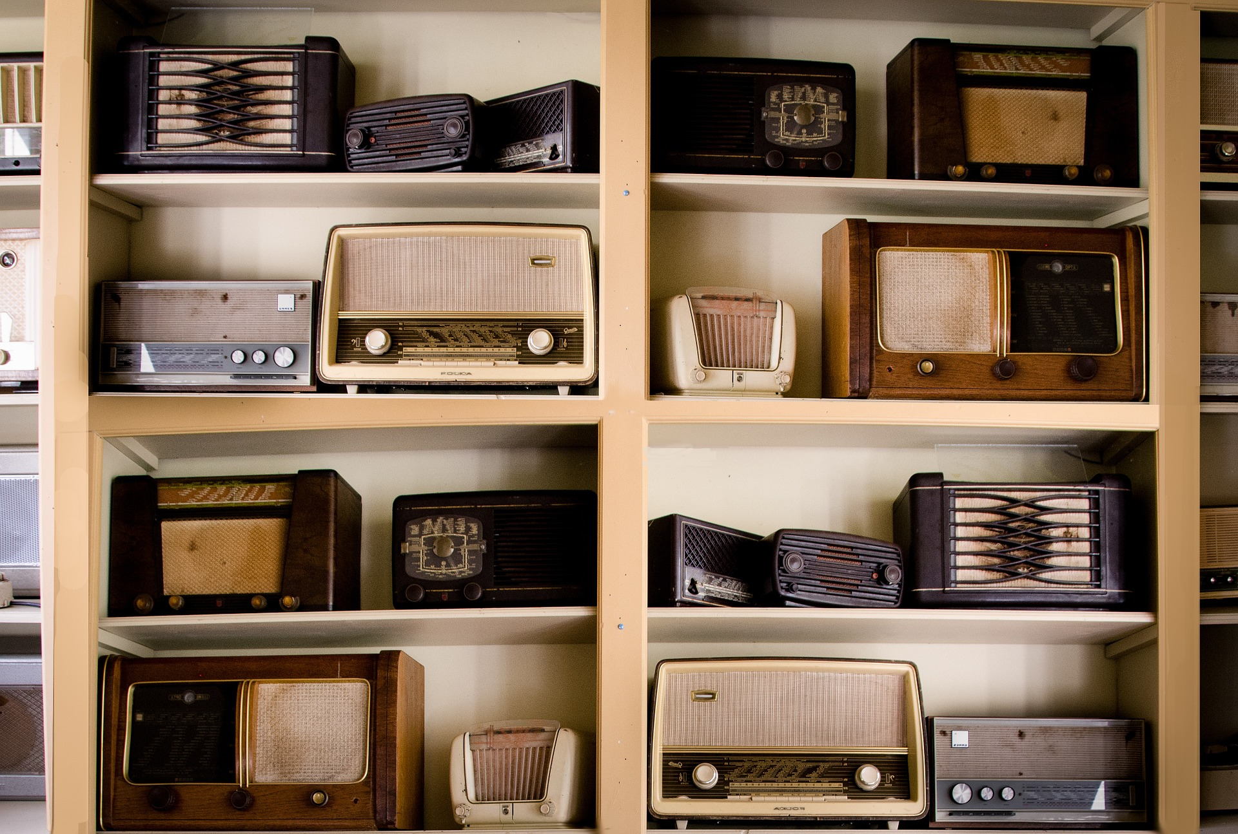
Baseball in the 1920’s
1st Radio Broadcast
August 5, 1921
Pittsburgh Pirates vs Philadelphia Phillies
Pirates won 8-5
10

Slide 12
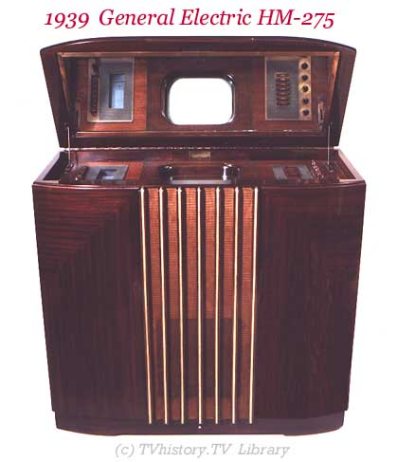
Baseball in the 1930’s
August 26, 1939
1st TV broadcast
Brooklyn Dodgers vs Cincinnati Reds
4,600 TV sets in American homes
11

Slide 13
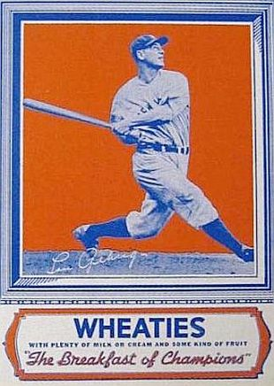
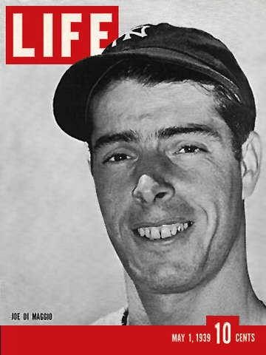
Baseball Stars in the 1930’s
Lou Gehrig
Joe DiMaggio
12

Slide 14
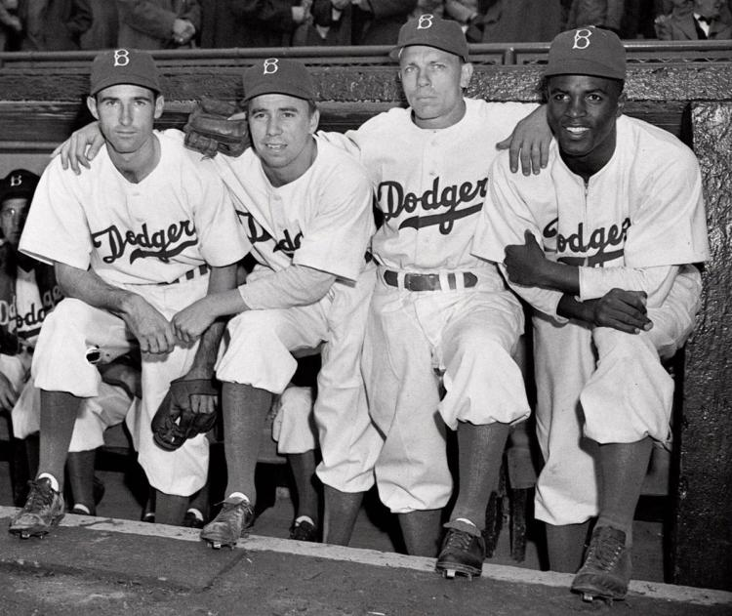
Baseball Stars in the 1940’s
Jackie Robinson
First African American to play in the major leagues
(1947)
13

Slide 15
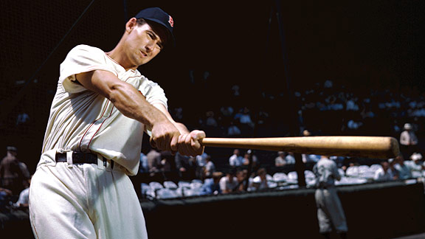
Baseball Stars in the 1950’s
Ted Williams
“Splendid Splinter”
Served in two wars:
World War II Navy Pilot
Korean War Marine Pilot
* Colonel John Glenn was his squadron commander
14

Slide 16
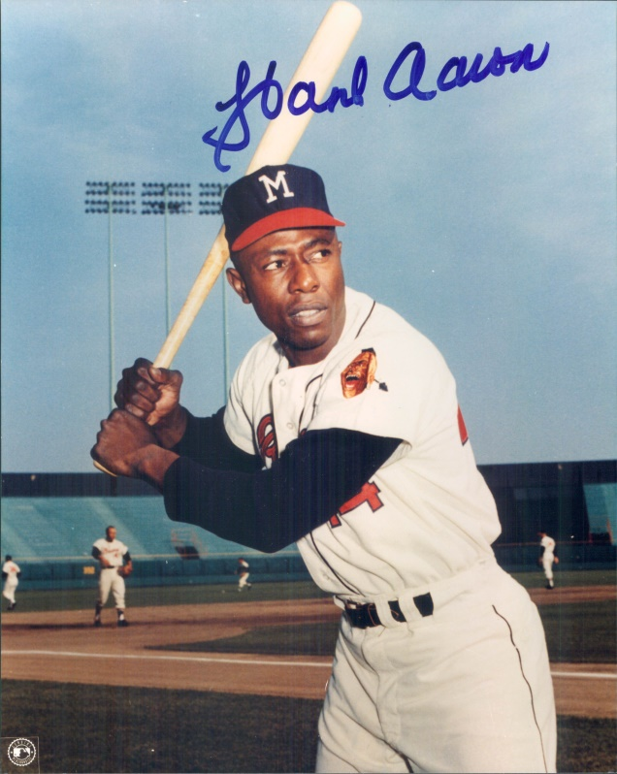
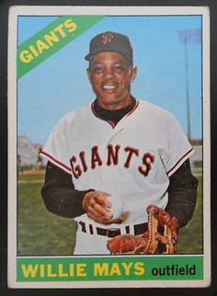
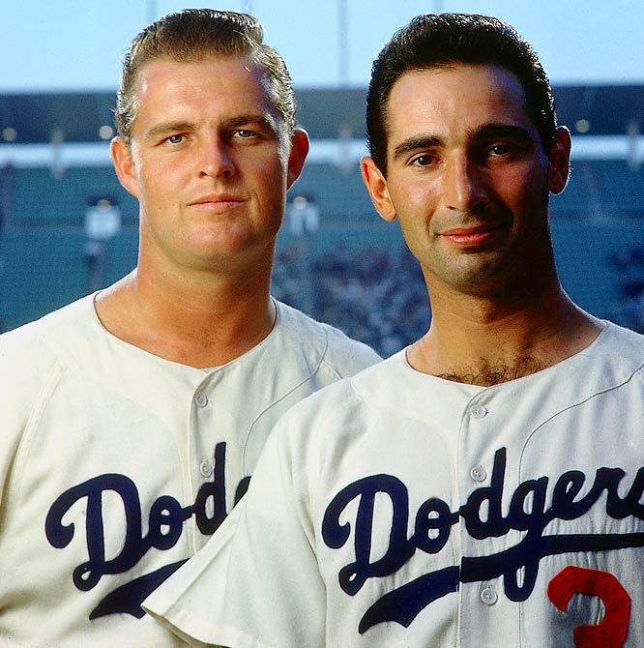
Baseball Stars in the 1960’s
Don Drysdale
Sandy Koufax
Hank Aaron
Willie Mays
Pitchers
Home run hitter
Outfield
15

Slide 17
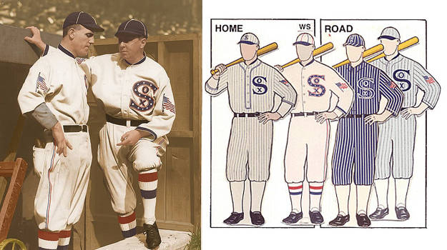
Baseball Uniforms
The home team wore white and the visiting team wore gray
16

Slide 18
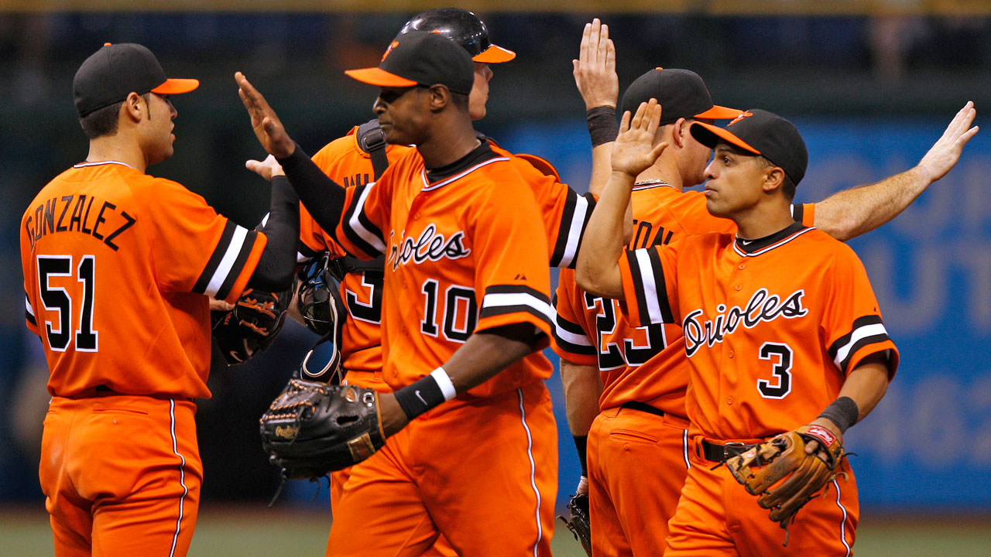
Baseball Uniforms in the 1970’s
An explosion of color!
17

Slide 19
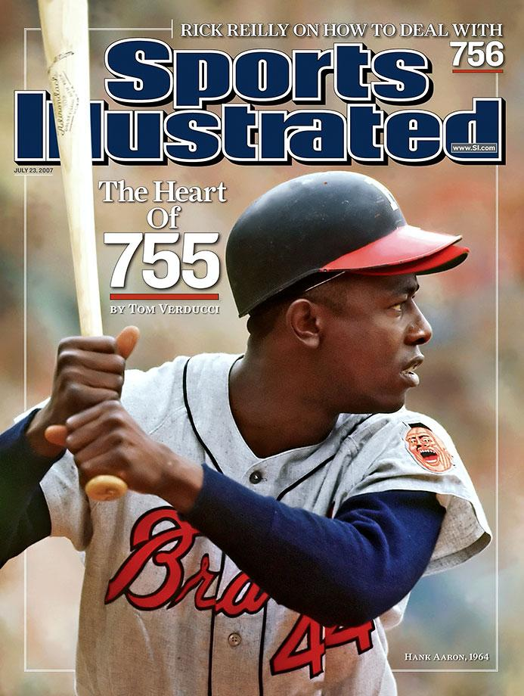
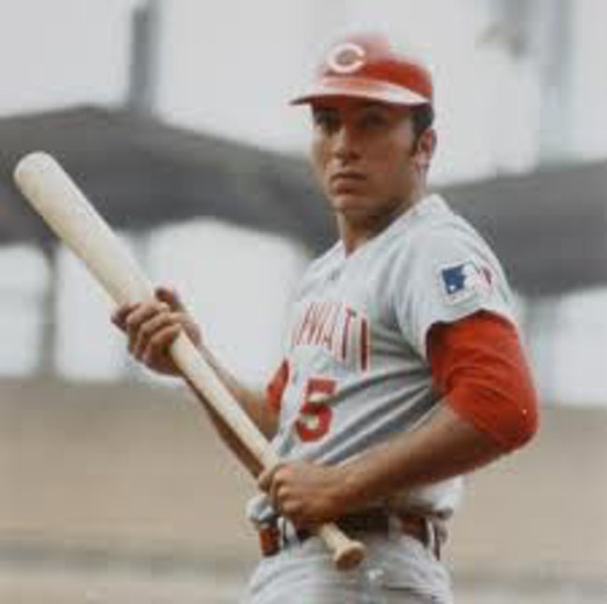
Baseball Stars in the 1970’s
Hank Aaron
Johnny Bench
Broke Babe Ruth’s homerun record
Catcher
18

Slide 20
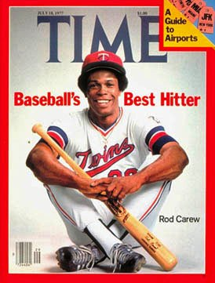
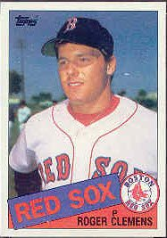
Baseball Stars in the 1980’s
Rod Carew
Roger Clemens
First & second base
Coached
Pitcher
19

Slide 21
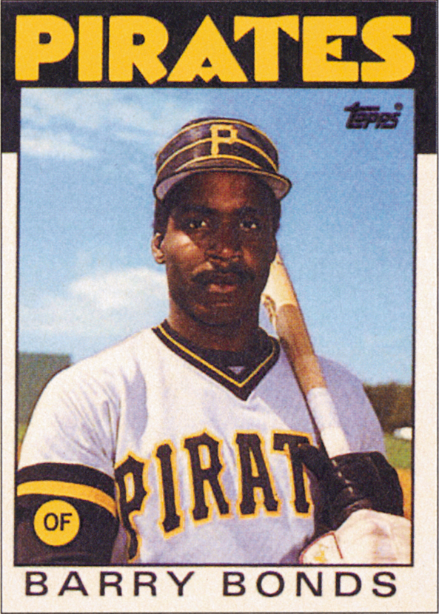
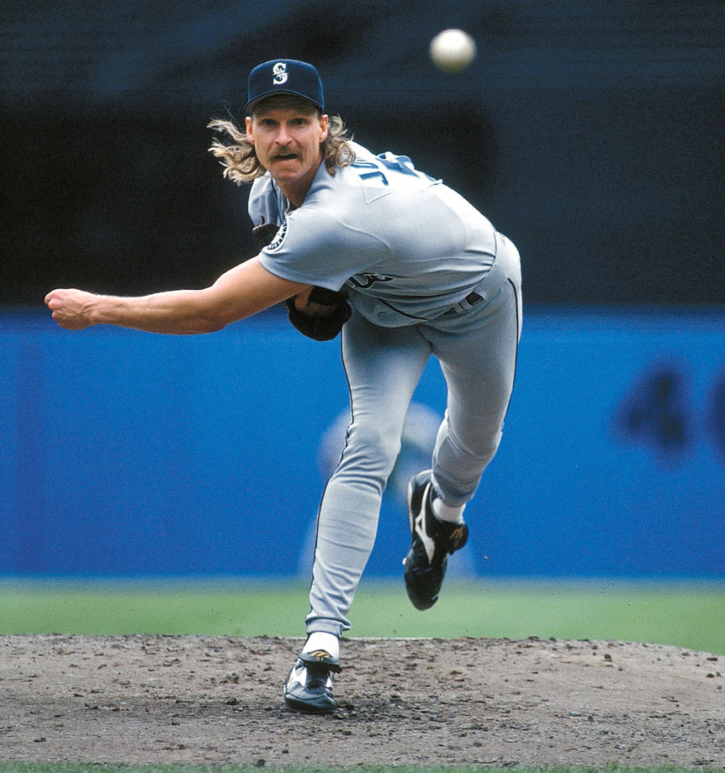
Baseball Stars in the 1990’s
Randy Johnson
Barry Bonds
Pitcher
Hitter
20

Slide 22
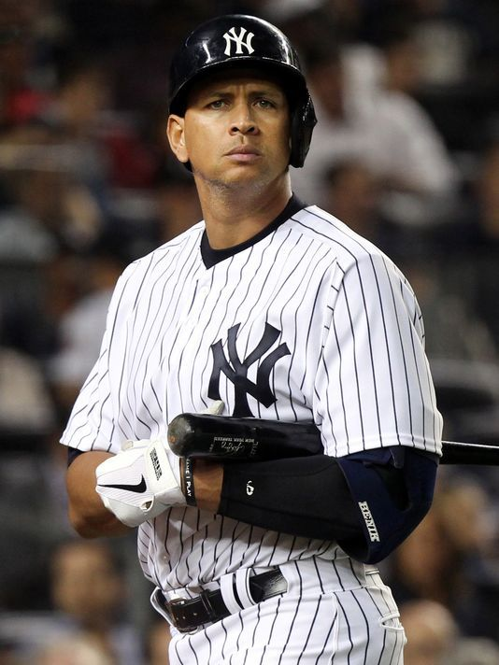
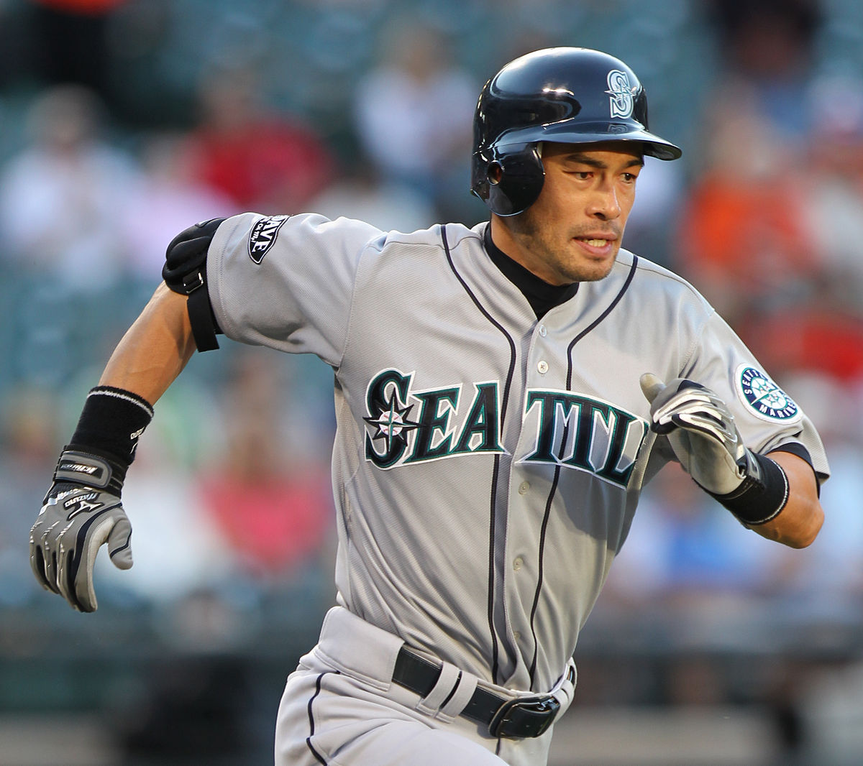
Baseball Stars in the 2000’s
Alex Rodriquez
Ichiro Suzuki
Right field, hitter
Shortstop, hitter
21

Slide 23
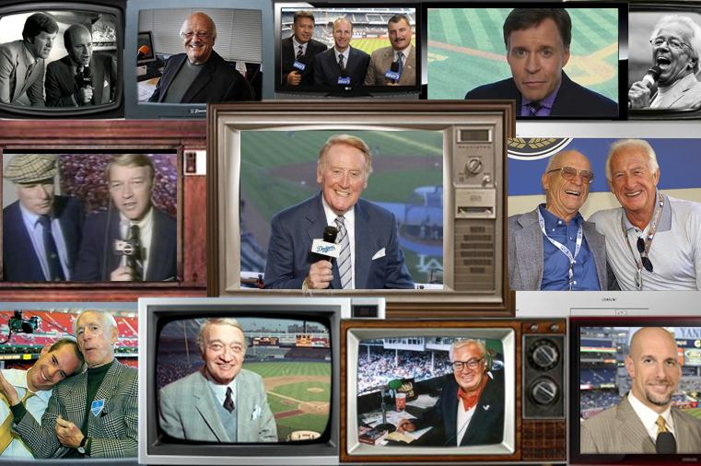
Baseball Announcers
Bob Costas
Bob Uecker
Vince Scully
Harry Caray
22

Slide 24
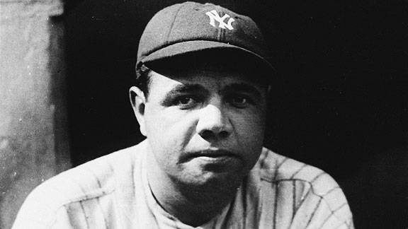
#1 Baseball Star of All Time
George Herman Ruth “Babe Ruth”
714 Homeruns
2,873 hits
2,174 runs
Gave hope to millions during the Great Depression
23

Slide 25
#1 Babe Ruth
“It wasn’t that he hit more home runs than anybody else. He hit them better, higher, farther, with more theatrical timing and a more flamboyant flourish.”
Red Smith
24

