Slide 1
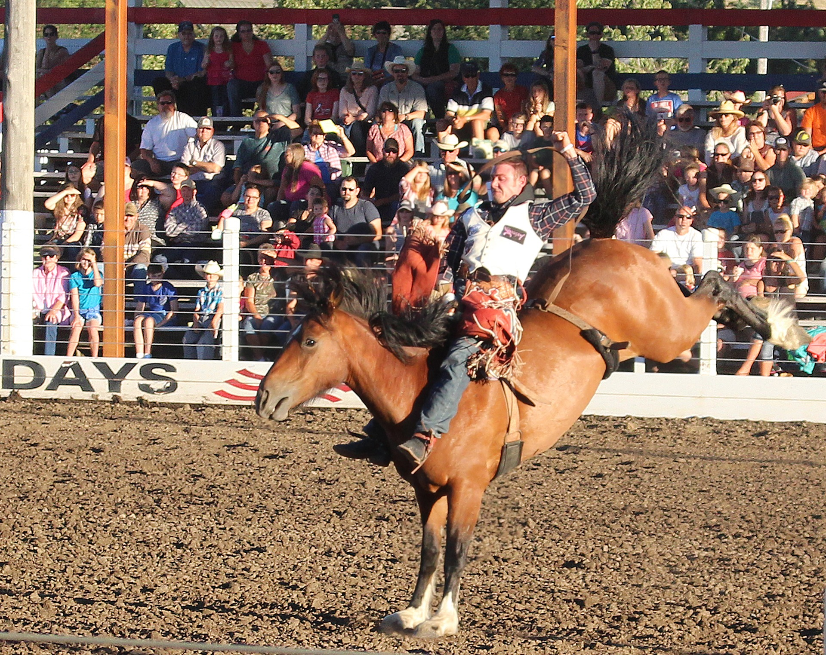

Slide 2
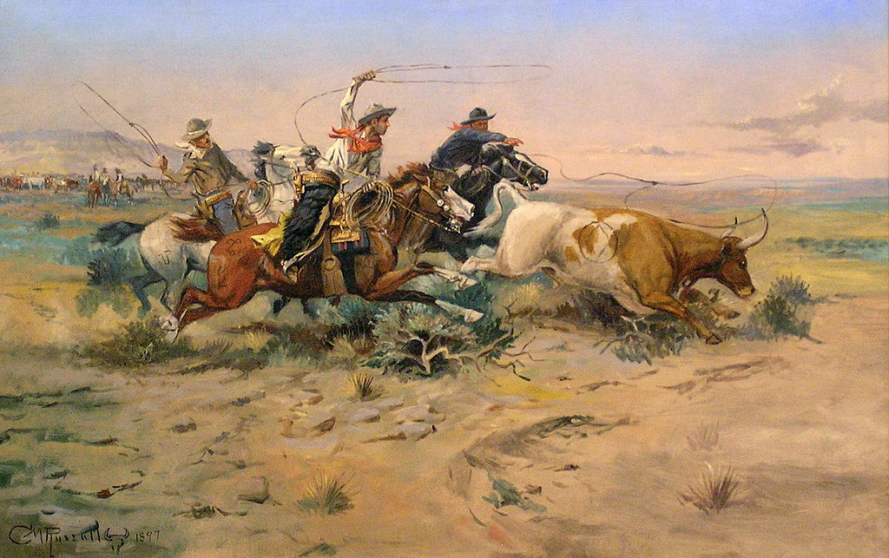
The Herd Quitter, 1902
What are these cowboys doing?
1

Slide 3
The Herd Quitter, 1902
What are these cowboys doing?
Rounding up cattle for branding or feeding
2

Slide 4
Montana Cattle Drive, 1890
Why do cowboys “round up” and move cattle?
3

Slide 5
Montana Cattle Drive, 1890
Why do cowboys “round up” and move cattle?
Fresh, spring grass
4

Slide 6
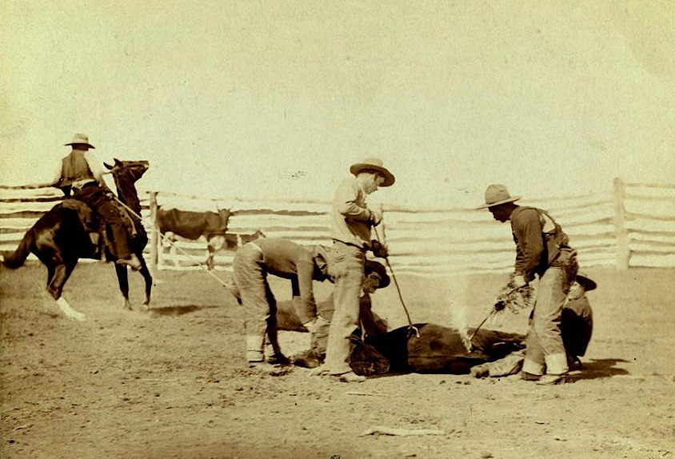
Cowboys Branding Cattle, 1888
Why do cowboys brand their cattle & horses?
5

Slide 7
Cowboys Branding Cattle, 1888
Why do cowboys brand their cattle & horses?
A brand identifies who owns the cow or horse
6

Slide 8
HH
Which brand do you like?
A
Double H
Rocking A
J
R
Diamond Ranch
Swinging J
7
R
7 Day Ranch
7

Slide 9
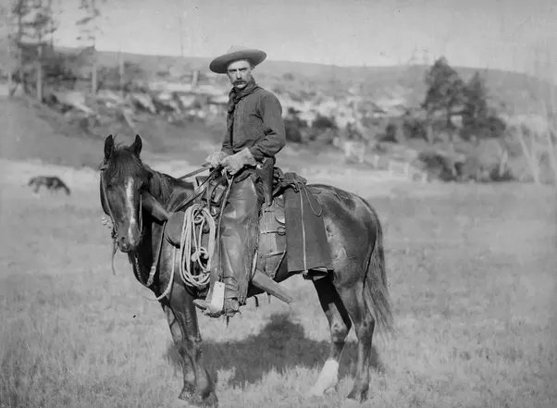
In the beginning
Traveling with the Spanish Conquistadors, cowboys from Spain arrived in Mexico
8

Slide 10
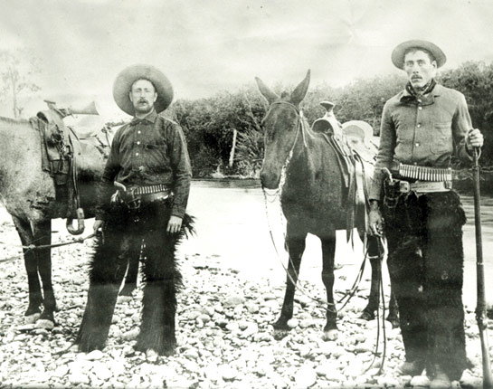
In the beginning
Cowboys from Spain and Mexico migrated North to America
9

Slide 11
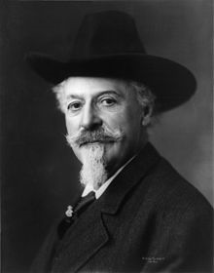
Buffalo Bill Cody 1846 - 1917
Dropped out of school to herd cattle
After the Civil War he was a
scout for the Army
Produced Wild West Shows
The Wild West Shows turned into Professional Rodeo
10

Slide 12
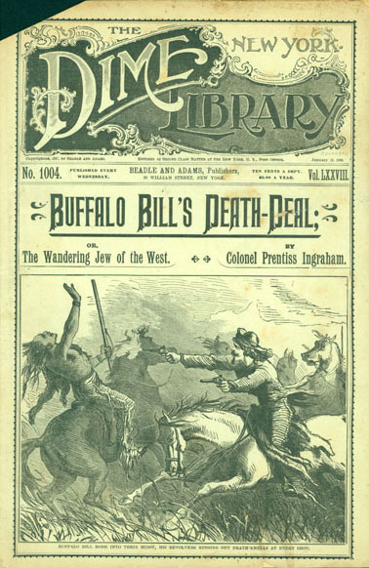
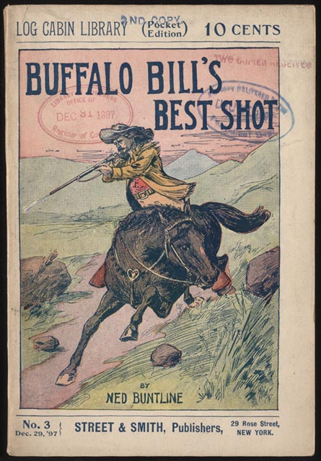
The Dime Store Novel
People all over the world loved reading about the “Wild West.”
11

Slide 13
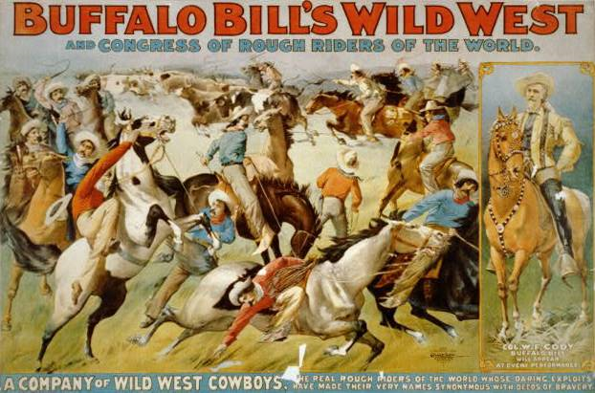
Wild West Show
12

Slide 14
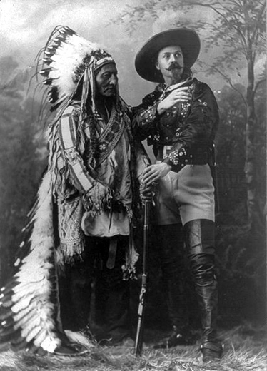
Sitting Bull and Buffalo Bill
Who performed in Wild Bill’s shows?
13

Slide 15
Sitting Bull and Buffalo Bill
Who performed in Wild Bill’s shows?
Native Americans
Sharp Shooters
Fancy & novel riders
14

Slide 16
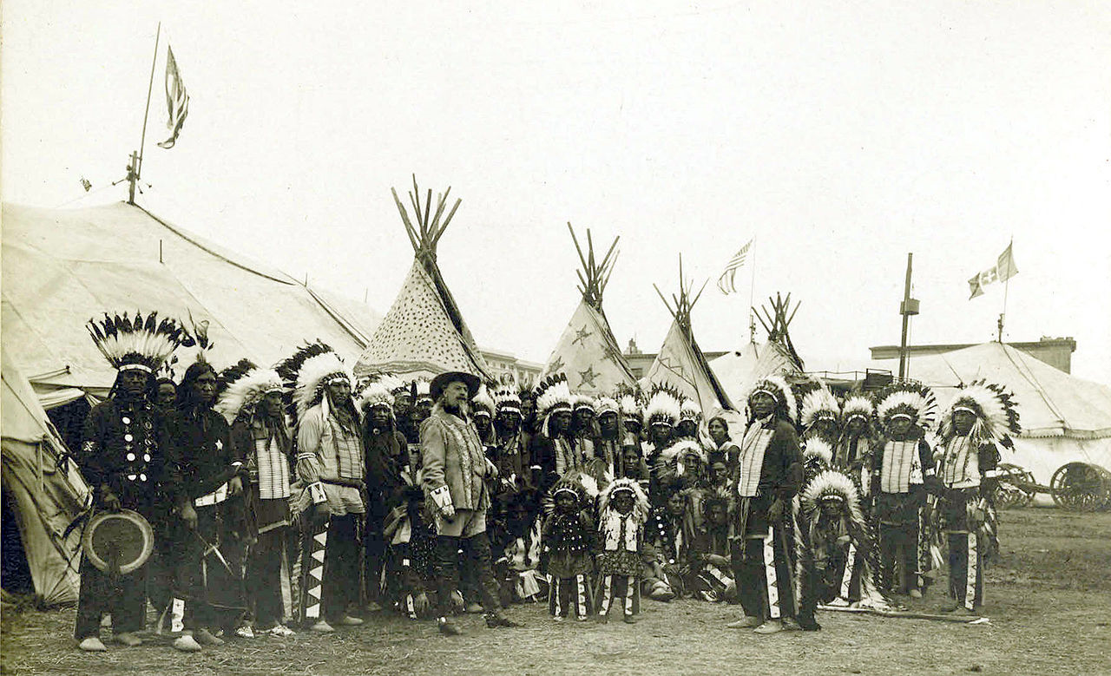
Sitting Bull and Buffalo Bill Wild West Show
15

Slide 17
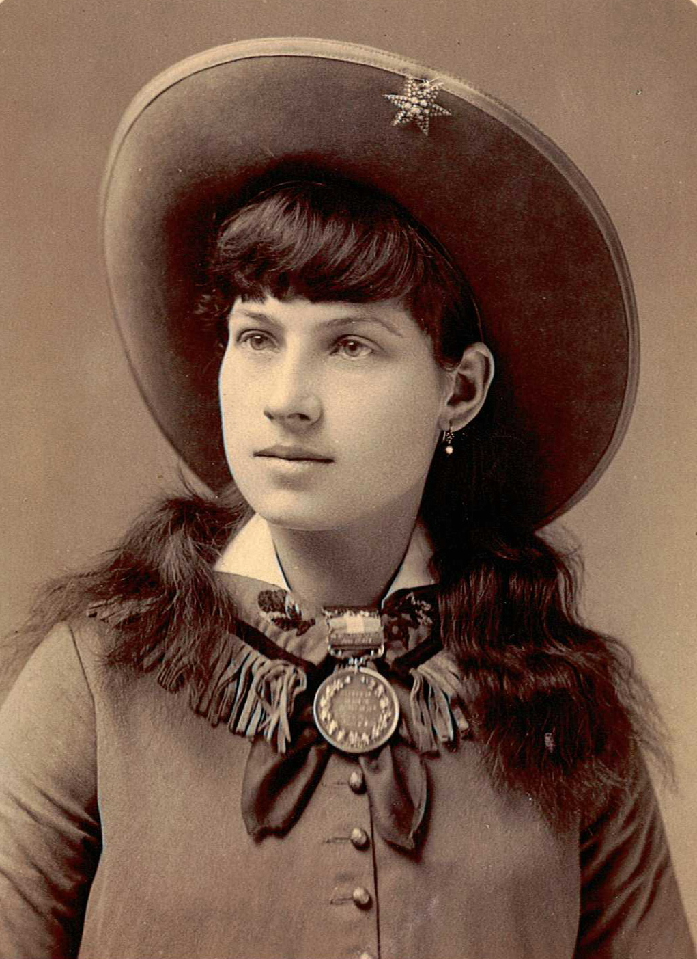
Annie Oakley 1860 - 1926
Wild West performer
Taught over 15,000 women to shoot
16

Slide 18
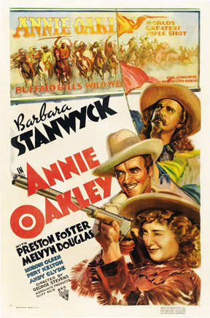
Annie Oakley 1860 - 1926
Annie’s nickname was “little sure shot”
17

Slide 19
Prescott, Arizona 1888
Home of the world’s “oldest” rodeo
18

Slide 20
Calgary Stampede Rodeo Parade 1925
19

Slide 21
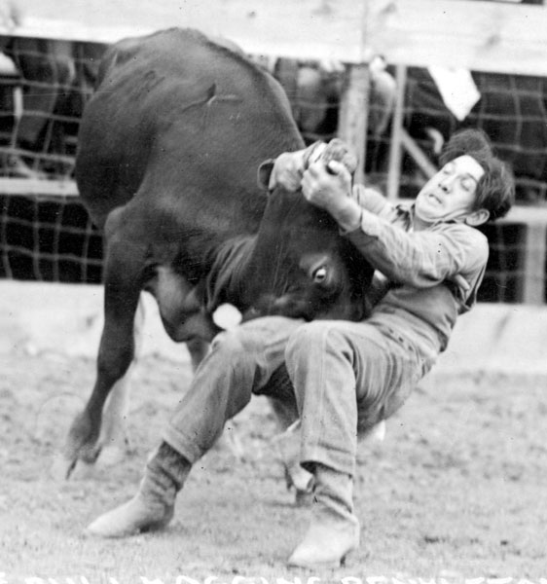
The Pendleton Roundup, Oregon
20

Slide 22
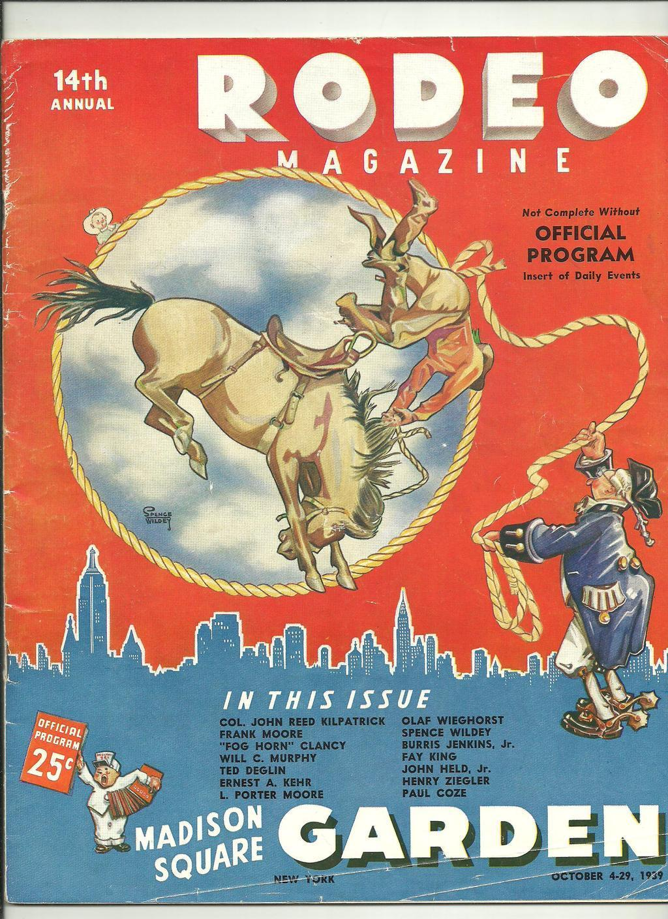
Madison Square Garden Rodeo 1922
Professional Rodeo
Cowboys competed for large, shiny belt buckles and cash
21

Slide 23
Lucille Mulhall 1895 - 1940
Women competed as trick riders and in an event called “Barrel Racing”
22

Slide 24
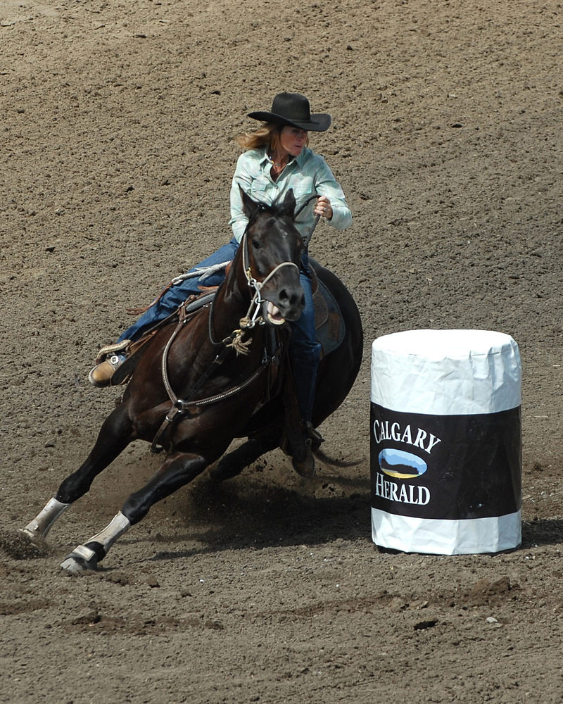
Women’s Events: Barrel Racing
23

Slide 25
Movie Star Cowboys
Gene Autry
Autry owned the Madison Square Garden Rodeo
24

Slide 26
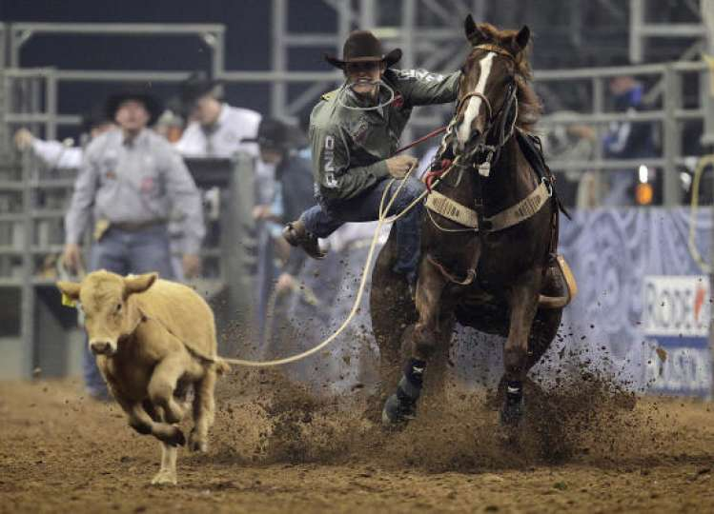
Calf Roping
25

Slide 27
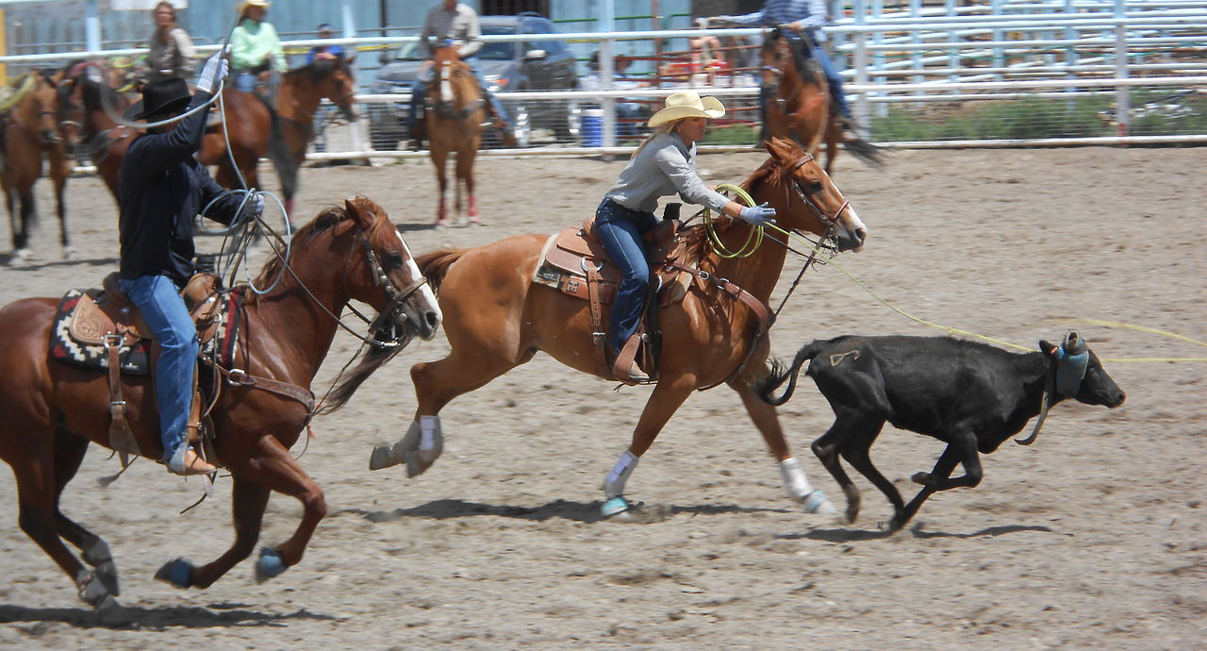
Team Roping
26

Slide 28
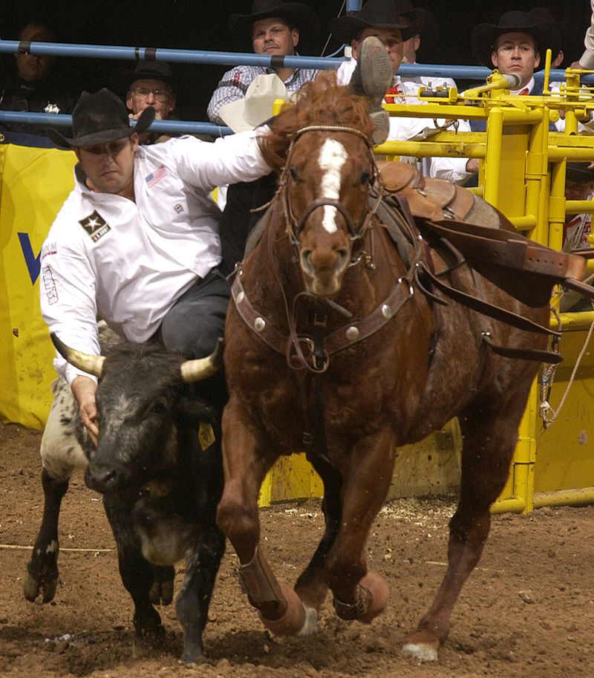
Steer Wrestling
27

Slide 29
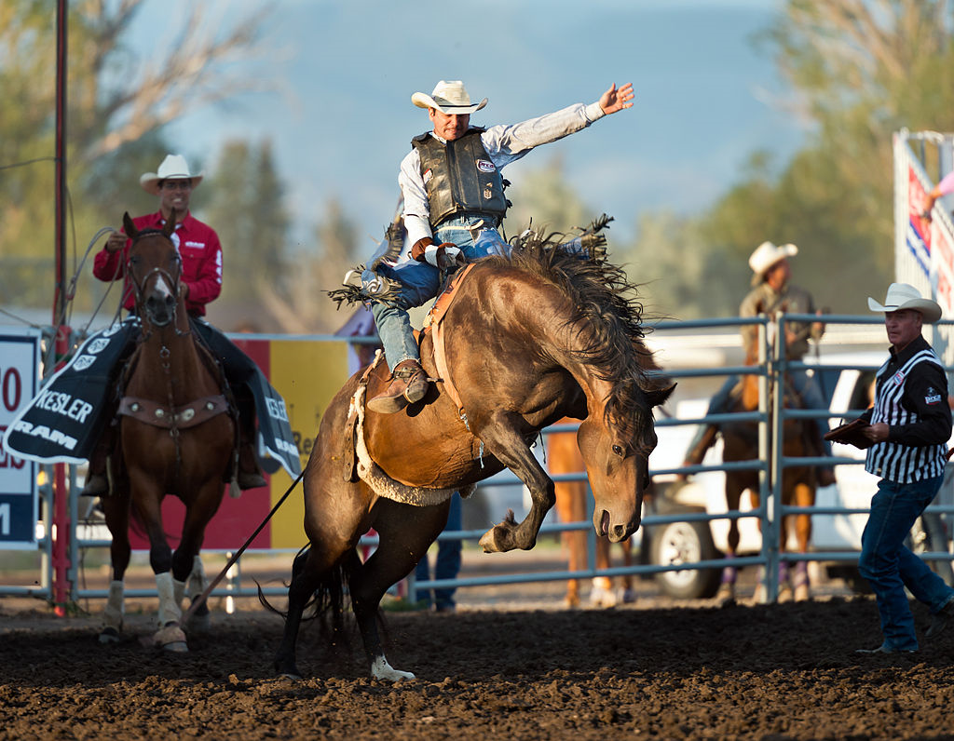
Bucking Broncos
28

Slide 30
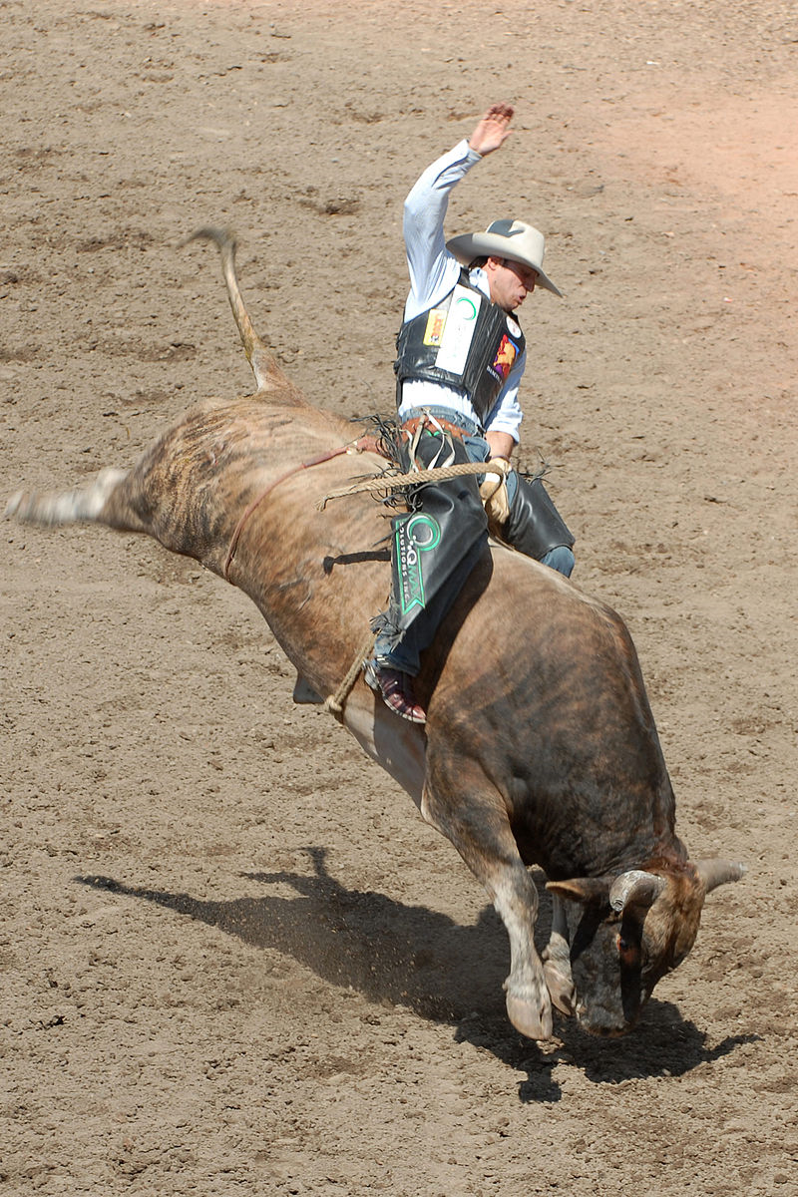
Bull riding
29

Slide 31
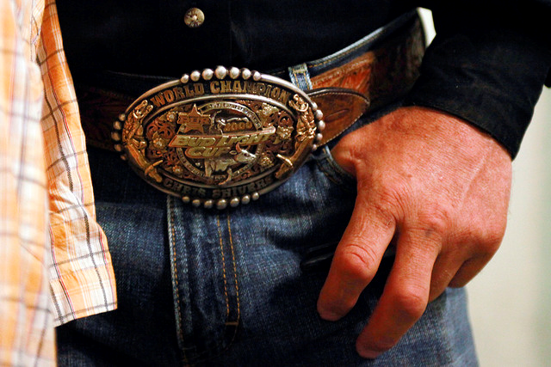
The Prize
30

